Slide 1
QCD studies with the CMS detector
Paolo Bartalini
(National Taiwan University)

Slide 2
QCD Goal at the LHC Consolidate the SM before attacking the discoveries (not necessarily all available at the LHC Start-up)
Quantum Chromo Dynamics: SU(3)_{C}
Non abelian O(10⁻¹) theory describing the interactions of the hadronic matter, spanning from perturbative to non perturbative:
q → qg, g → gg, g → ggg, fragmentation (strings, clusters, etc.), hadronization
Asymptotic Freedom, Confinement, Stability of the proton
Confront with QCD calculations for basic Event & Jet distributions
α_{s}, PDFs (Same range explored by HERA with O(10²-10³) higher virtuality: scaling violations ?)
Measure Multiple Parton Interactions
Still missing a solid TH description (Extension of the factorization)
Monte Carlo Tuning

Slide 3
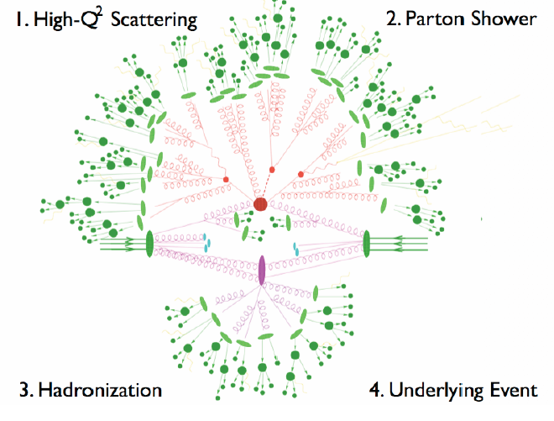
Monte Carlo Models at the LHC
Extra gluon emission described with ME at the highest possible order (+matching). Spin correlations needed.
2→2(+3, 4) LO ME:
Alpgen, MadGraph,
SHERPA, HELAC
NLO ME:
POWHEG, MC@NLO.
Tune masses, widths,
Choose best & error PDFs
Pythia6, Pythia8, Herwig, Herwig++, Sherpa. Tune ISR, FSR.
TUNING
INTERPLAYS !!!
General Purpose MC used in (2) implementing fragmentation models (Strings, Clusters etc.) . LEP Tunes sufficient ?
MPI desirable (All Pythia, Jimmy, Herwig++, Sherpa).
PERTURBATIVE!!!
Tune P_{T} cut-off (CGC),
Correlation param.

Slide 4
QCD studies with the CMS detector
Outline
See also the introductory talk
of Greg Landsberg!
Performances of the CMS Detectors
Event Measurements
Min Bias Multiplicities, η & P_{T} Spectra (Pixel)
Underlying Event (Full Tracker)
Event Shapes (Full Tracker & Calo Towers)
Jet Reconstruction & Measurements
Jet Shapes (Full Tracker & Calo Towers)
Jet Energy Scale (also with Photons, i.e. EM Calo)
Jet Energy Resolution (Calo Jets Energy)
Inclusive Jet dσ/dP_{T} (Calo Jets Energy)
Di-jet Mass (Calo Jets Energy)
Di-jet φ Decorrelations (Calo Jets Azimuth)
Tracker,
LOW P_{T}
Calo,
HIGH P_{T}

Slide 5
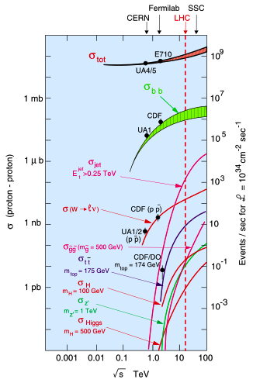
Final States at the Large Hadron Collider
Tevatron
O(fb⁻¹) measurements
LHC
Jet σ at 0.25 TeV are O(10²) higher
Same total rates with O(10pb⁻¹)
Early measurements not statistically limited
First look on relevant SUSY/BSM backgrounds with some improved performances on contact interactions & high mass O(TeV) resonances.
LHC Start-up (I)
LHC Start=up (II)

Slide 6
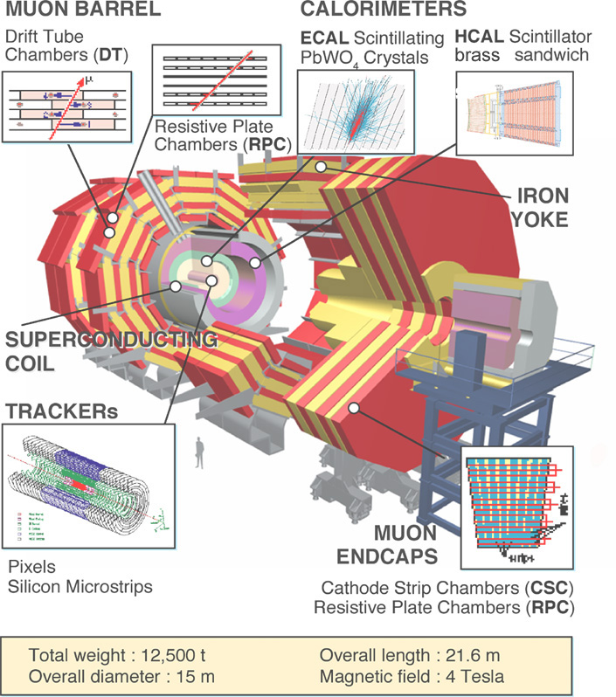
CMS Design features
See also the introductory talk
of Greg Landsberg!
Detectors
CMS design choice: optimize performance for muon/track momentum resolution and electromagnetic energy resolution....
Long 4 Tesla Solenoid containing Tracker, ECAL and HCAL
Tracking up to η ~ 2.4
μ system in return iron
First μ chamber just after Solenoid
(max. sagitta)
Big lever arm for P_{T} measurement
Event Rates: ~10⁹ Hz
Event size: ~1 MByte
Level-1 Output 100kHz
Mass storage 10²Hz
Event Selection: ~1/10¹³

Slide 7
CMS Detectors relevant for QCD Measurements
Basic performance numbers
HCAL
Cu (absorber) + Plastic (scintillators) up |η| ~ 3.0
ECAL
PbWO4 crystals up |η| ~ 3.0
Tracker
Si μ-strip detectors + Pixel up |η| ~ 2.4
Complemented by the CMS Forward detectors:
Hadron Forward Calorimeter HF: 3 ≤|η| ≤ 5 → MB Trigger
Castor Calorimeter: 5.2 ≤|η| ≤ 6.5
Beam Scintillation counters BSC
Zero-Degree Calorimeter ZDC
P_{T}^{max} ~ √s exp(-η)

Slide 8
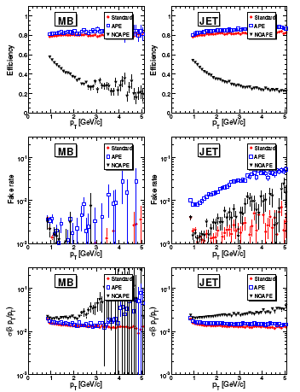
Tracking performances
MB and Jet events
1 pb⁻¹
Efficiency and fake performances at the LHC start-up are recovered using APE (error to the hits taking into account alignment precision)
CMS Physics Analysis Summary QCD-07-003
Ideal aligned detector
Misaligned + APE
Misaligned
CMS tracking optimized for P_{T}>900 MeV/c
Seeding and tracking from 500 MeV/c is also possible with sufficient high efficiency (>70%) and fakes under control (<2%)

Slide 9
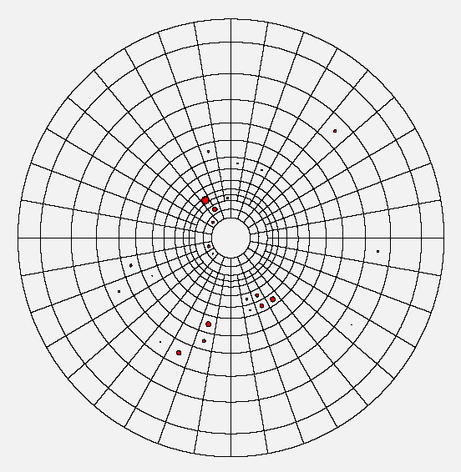
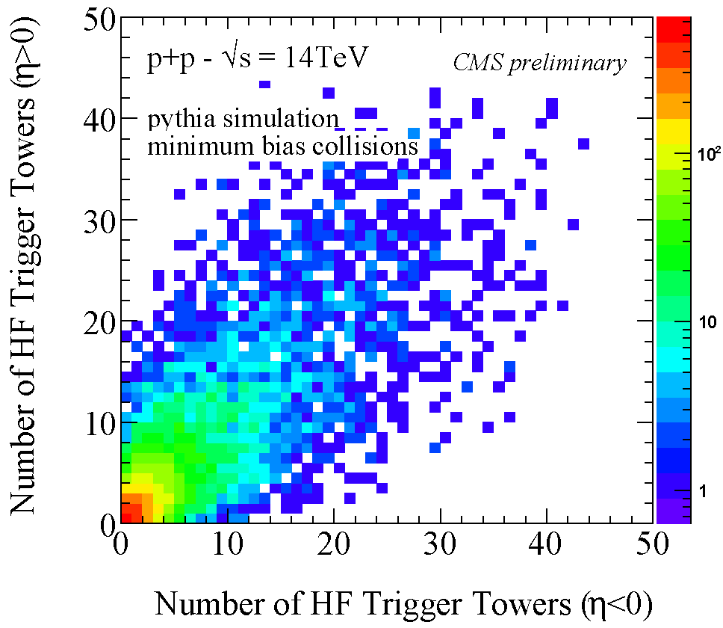
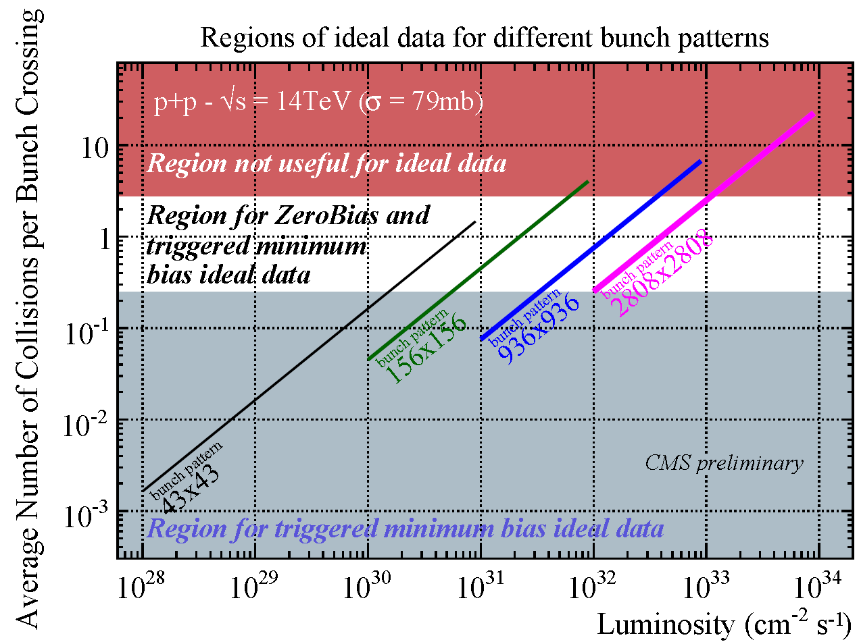
MB Trigger
Based on Hadron Forward (HF) Calorimeter
1 pp interaction
3<|η|<5
18 wedges/side
0.175x0.175 η−φ
Noise per
Tower << 1 GeV:
HF is a good
particle counter!
Using
towers
fired
E>1.4 GeV
Can handle both Single and Double Sided Requests on # of HF Towers. Example of working point (Single) →
81% Non-Diffractive
15% Single-Diffractive
15% Double-Diffractive
Double requests get rid of Single Diffr.
CMS Physics Analysis Summary QCD-07-002
J. Phys. G: Nucl. Part. Phys. 34 (2007) 2307-2455

Slide 10
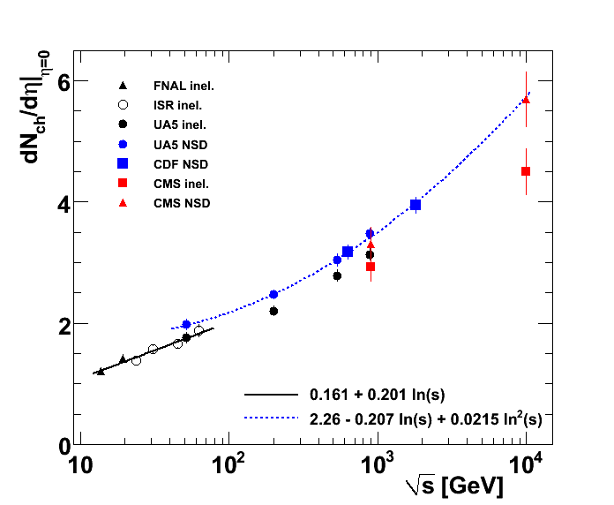
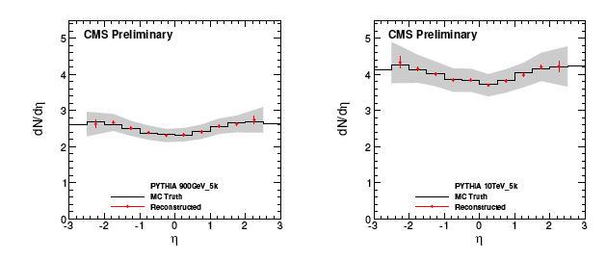
MB: Charged Multiplicity, Very Early Analysis (50 mb⁻¹)
Low-level physics objects used hits from pixel detector only instead of full tracking
Tracking Down to P_{T} = 75 MeV/c !
From pixel hits and primary vertex, particles density and η are estimated layer by layer
BKG estimated from data (Δφ sidebands)
Doesn’t depend on Pixel ADC count response
Sensitive to misalignment
1. HIT
3. Tracklet
Layer 2
Layer 1
2. Vertex
900 GeV
Systematics ~10%
CMS Physics Analysis Summary QCD-09-002
Systematics ~10%
10 TeV
Notes:
In this note, a tracklet-based analysis of the charged hadron multiplicity is presented. The main
advantage of this method is that the combinatorial background can be determined directly
from the data and looper particle contributions can be suppressed by selection. This provides
the possibility to reconstruct the charged particle spectrum, dN/dh with a method which is
simple and less sensitive to detector response simulation. With corrections from Monte Carlo
simulation, the total systematic error is at the 10% level. With 5000 events, which corresponds
to an integrated luminosity of 50 mb−1, this method can provide a reliable study of the early
p+p collisions at the LHC.

Slide 11
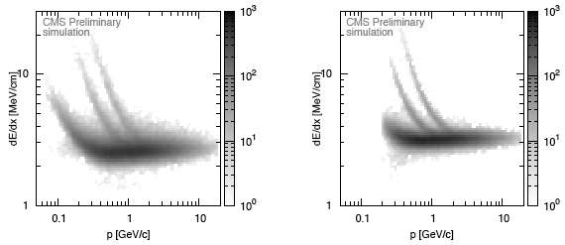
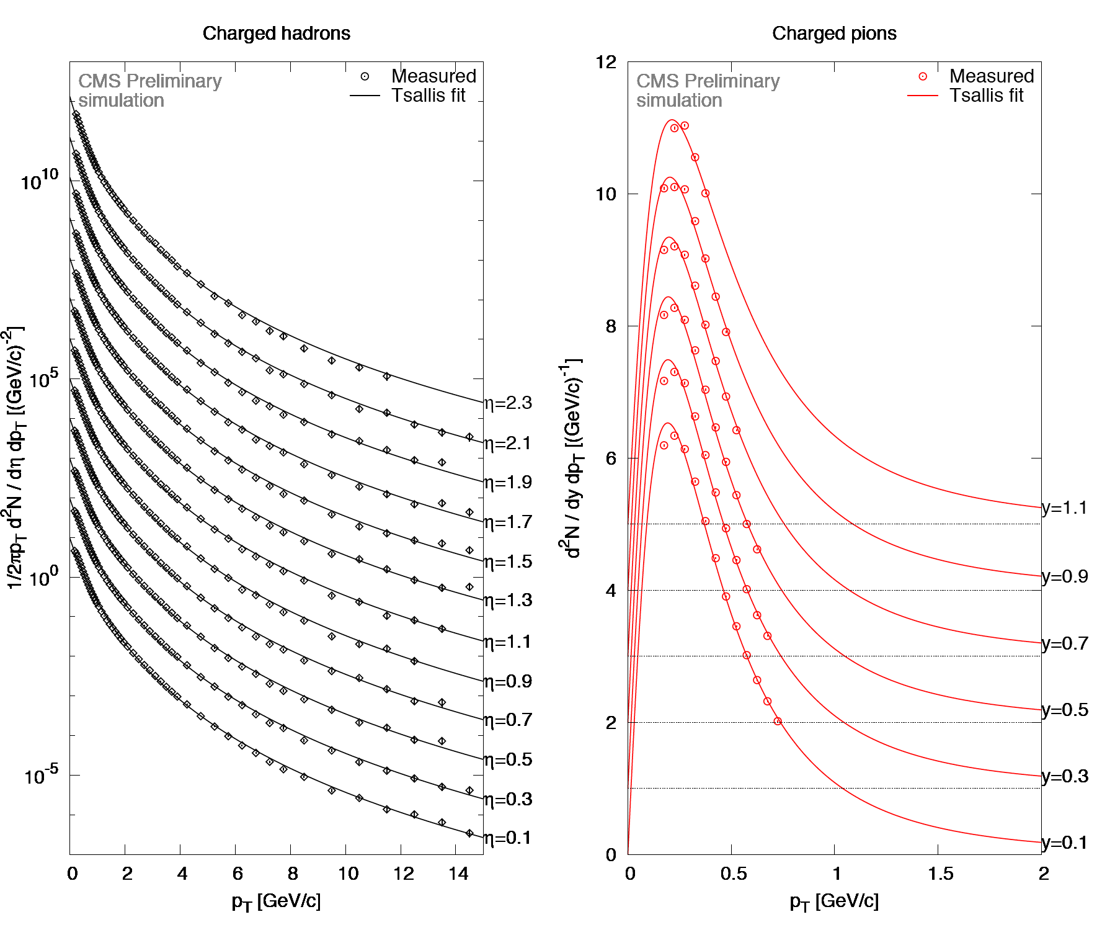
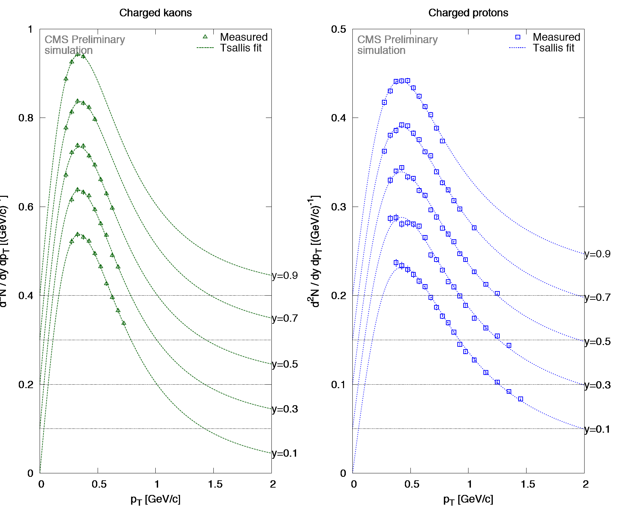
MB: P_{T} Spectra of Charged Hadrons
K±
p
Si-μ−Strip
π±
Pixel
Diff. yields of identified π±, K±, p/p̅ together with Tsallis-function fits
(inverse slope T = 0.2 GeV/c, high PT exponent n = 7.2)
dE/dx (MeV/cm)
Charged hadrons
pions
kaons
protons
CMS Physics Analysis Summary QCD-07-001
Notes:
Cross-sections and differential yields of charged particles (unidentified or identified pions,
kaons and protons), produced in inelastic proton-proton collisions at ps = 14 TeV, can be
measured with good precision with the CMS tracker. While in the case of yields (dN/dpT) the
systematic uncertainties are dominated by the correction due to missing events, in the case of
differential cross-sections (ds/dpT) a smaller systematic error is foreseen. This results from the
expectation that the luminosity measurement will be more precise than the knowledge of the
trigger inefficiency. This analysis opens the door to several follow-up physics analyses are possible:
comparisons to theoretical models at low and high pT; study of multiplicity distributions;
studies of multiplicity and energy dependence of mid-rapidity density and average transverse
momentum.

Slide 12
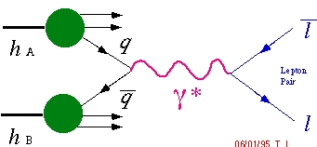
Underlying Event Observables
2π
Jet #1
Direction
“Away”
Region
Δφ
MB and Jet events
“Transverse”
Region
“Toward”
The Calo jet (or Charged jet) provides a scale
and defines a direction in the φ plane
The transverse region is expected to be
particularly sensitive to the UE
Several Jet topologies can be tested to increase the sensitiveness to the MPI component of the UE
“Transverse”
“Transverse”
“Toward”
Region
jet1
“Away”
φ
Main observables built from charged tracks:
+ dN/dηdφ, charged density
+ d(P_{Tsum})/dηdφ, energy density
“Transverse”
Region
“Away”
Region
0
LHC experiments have a much wider Δη region
with respect to the Tevatron ones
-2 2
η
DY events
observables are the same
The P_{T} of the boson is used to define a direction

Slide 13
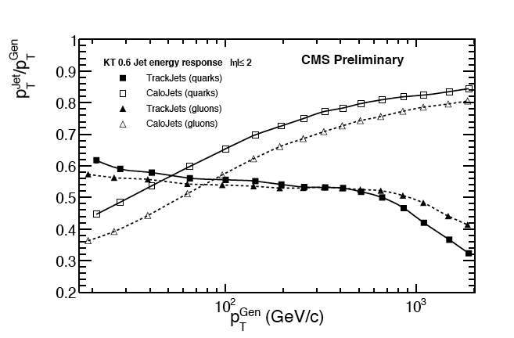
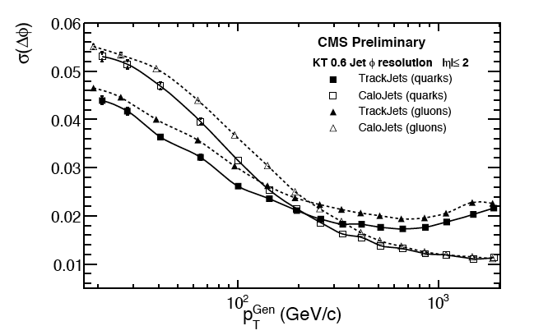
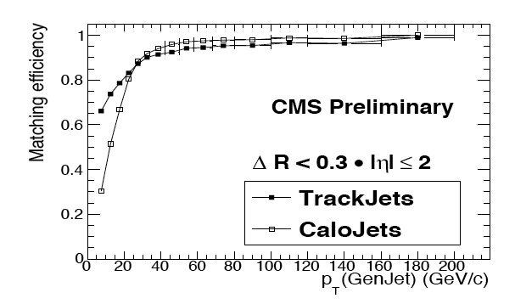
Track Jets
(Let’s anticipate some results on Jet reconstruction further information in next slides….)
Within the tracker acceptance the jet finding efficiency with Track Jets is higher than for Calo Jets for P_{T} ≤ 30 GeV/c.
The angular resolution of Track Jets is better than for Calo Jets for P_{T} ≤ 200 GeV/c, mainly for the φ resolution.
Track Jets are intrinsically more robust against Pile-up.
φ
CMS Physics Analysis Summary JME-08-001

Slide 14
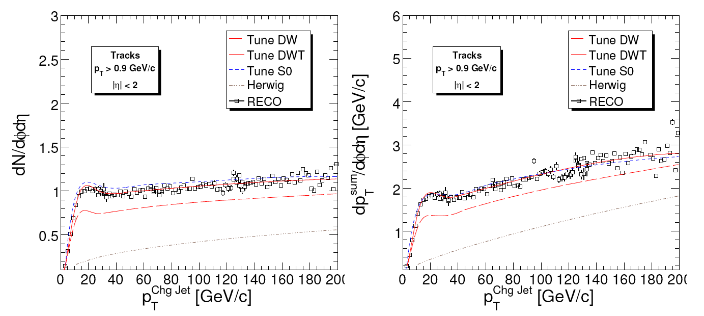
UE in the Transverse Region (with Tracks)
Select charged tracks in | η | < 2 with P_{T} > 0.9 GeV/c
Profiles corrected for Tracking Inefficiency & Fakes
+ Pythia Tune DW (ε=.125)
OLD MPI, IP CORRELATIONS, ~ TUNE A
+ Pythia Tune DWT (ε=0.08)
DW with default P_{T}-cut-off evolution
+ Pythia Tune S0 (ε=0.08)
P.Skands, New MPI, colour-flow
All these Pythia tunes describe
MB & UE at Tevatron. Further information in backup slides.
CMS Preliminary
CMS Preliminary
√s = 14 TeV
S0
√s = 14 TeV
CMS Physics Analysis Summary QCD-07-003
DWT
DWT
(input to RECO is DWT)
DW
DW
Herwig “Soft UE”
Herwig “Soft UE”
∫ L dt = 100 pb⁻¹
∫ L dt = 100 pb⁻¹
→ discriminate DW against DWT
For P_{T} > 0.5 GeV/c
Discriminate S₀ against DW/DWT
Early CMS MC Tunes

Slide 15
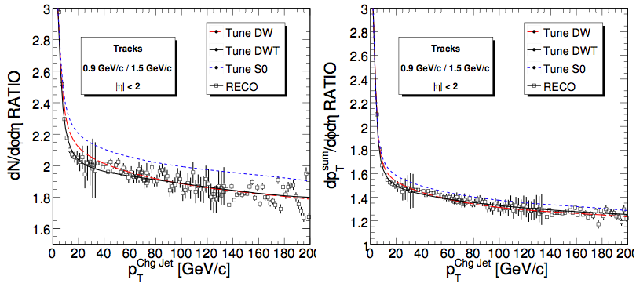
UE Ratios in the Transverse Region
Ratios between uncorrected UE-observables:
UE-density(P_{T}(track) > 0.9 GeV/c) / UE-density(P_{T}(track) > 1.5 GeV/c)
No additional track reconstruction corrections needed!
track reconstruction performance uniform in P_{T} for P_{T} > 0.9 GeV/c
CMS Preliminary
CMS Preliminary
√s = 14 TeV
√s = 14 TeV
∫ L dt = 100 pb⁻¹
∫ L dt = 100 pb⁻¹
(input to RECO is DWT)
CMS Physics Analysis Summary QCD-07-003
Early CMS MPI Tunes
→ discriminate S₀ against DW/DWT

Slide 16
Jets
Jet Algorithms:
Seedless Cone, R=0.5, 0.7
K_{T}, D=0.4, 0.6
Iterative Cone, R=0.5
Not I.R. safe, being replaced in the analyses, still used in the Trigger
Jet reconstruction strategy in CMS
From Calorimeter Towers
From Tracks
Very promising at the LHC Start-up
Combination of Calorimeter Towers + Tracks
Particles
as reconstructed in Particle Flow step

Slide 17
Calo - Jet Energy Scale
Mandatory Calibration Steps on Raw Reco Jets
Subtract Noise, Pile-up (can be done on a event by event basis)
Correct for not homogeneous η & P_{T} response
Use data (di-jet, γ-jet, Z-jet)
Start with Beam Test Calibration, 10% JES systematic at the LHC Start-up, Such figure will improve with the integrated Luminosity
γ-jet balance method
CMS Physics Analysis Summary JME-08-003
CMS Physics Analysis Summary JME-09-004
di-jet balance method

Slide 18
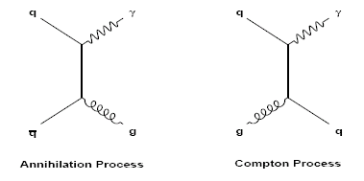
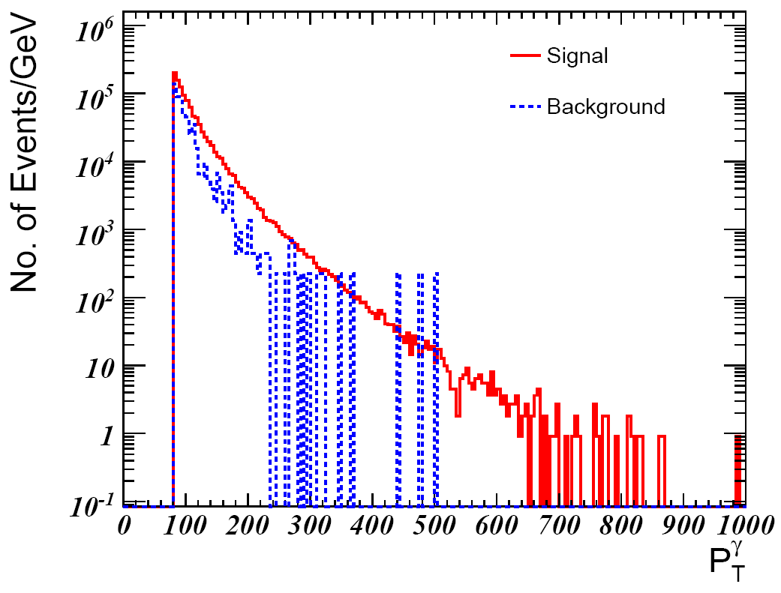
PHOTONS@LHC
Compton
Dominant
@LHC
(>80%)
Invaluable calibration tool
Lumi measurement, Detector response (see JES in previous slides)
Key ingredient for PDF measurement and in searches
Gluon PDF for x_{Bjorken} in the range 10⁻⁴ ÷ 10⁻¹
Higgs, RS Graviton, Unparticles: γγ
Extra-dimensions: γ+ ME
Annihilation
Compton
γ
Mostly High Lumi Objectives but significant rates to study γ at the LHC Start-up
1 γ/hour |η_{γ}| < 2.5 and P_{T}>20 GeV at 3*10²⁷ cm⁻²s⁻¹
Study of High P_{T} γ exploits isolation techniques
∫ L dt = 1 fb⁻¹
QCD jets
√s = 14 TeV
Eur. Phys. J. C 53, 49-58 (2008)

Slide 19
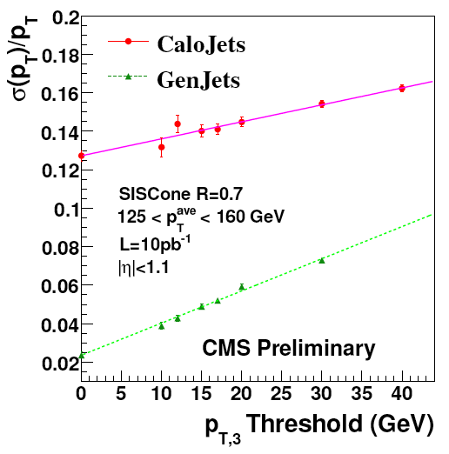
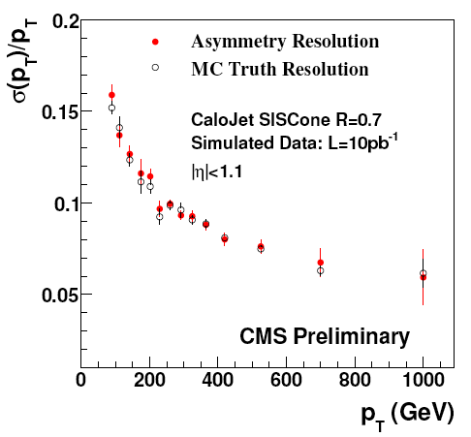
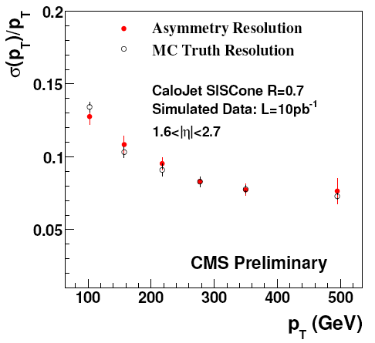
Calo - Jet Energy Resolution
Jet resolution is extracted from di-jet energy asymmetry.
In the limit of P_{T,3} → 0, σ((P_{T,1} - P_{T,2})/(P_{T,1} - P_{T,2})) → √2 σ(P_{T})/P_{T}
X-checked in Z(→μμ)+jet events
Agrees with MC Truth
CMS Physics Analysis Summary JME-09-007
Slightly improves at high η

Slide 20
Jet P_{T} Spectrum,
di-jet invariant Mass
di-jet φ Decorrelations

Slide 21
Initial Measurement of the Inclusive Jet x-section at √s = 10 TeV with 10 pb⁻¹
Measuring the rapidity and the P_{T} of all the Jets
I.R. Safe Jets SisCone & K_{T} Jets
Experimental uncertainties dominate at the LHC Start-up
Very steep P_{T} Spectra dσ/dP_{T} ≈ P_{T}^{q} , q ≈ 6÷12
Asymmetric migration of the events faking high P_{T} → Corrections
JES assumed uncertainty of 10% result in 60-120% uncertainties in the
JER has a smaller but still sensitive effect of ≈ 20% at low P_{T}
Luminosity, Trigger, Finite Reso also matter…
Stat Competitive with Tevatron 1 fb⁻¹ results for P_{T} > 250 GeV
Tevatron experience to compare with NNLO predictions
K_{T} less sensitive than SisCone to MPI and not perturbative effects
Improve limits on contact interactions up to Λ ≈ 3 ΤeV
Wait for better JES & LHC MC Tunes to constrain PDFs
CMS Physics Analysis Summary QCD-08-001

Slide 22
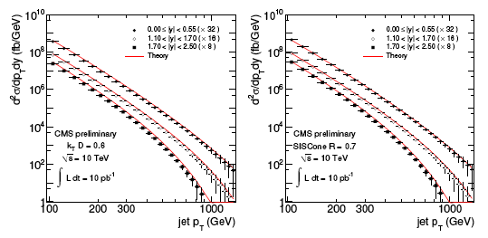
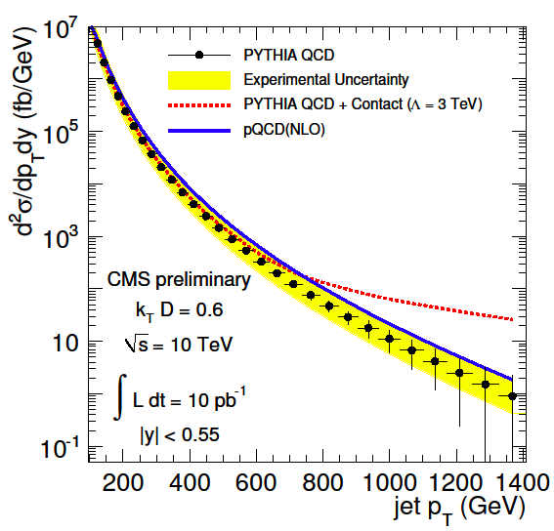
Corected Measured Spectra vs NLO
Initial Measurement of the Inclusive Jet x-section at √s = 10 TeV with 10 pb⁻¹
CMS Physics Analysis Summary QCD-08-001
Large High P_{T}
Stat
Measured Spectra
Λ = 3 TeV
Sensitivity to Contact Interactions
Notes:
A plan for the measurement of the differential inclusive jet cross section with early CMS data
from proton-proton collisions at ps = 10 TeV using two infrared and collinear safe jet algorithms
has been presented. The measurement covers the jet transverse momentum range from
100 GeV up to 1.4 TeV at central rapidity, which is the expected reach with an integrated luminosity
of 10 pb−1. This exceeds the reach of current collider experiments and motivates our
plan to make this measurement as early as possible in order to confront the QCD theory at the
TeV scale.
The experimental systematic uncertainties related to the jet energy scale, the luminosity and from the theory side by the development of a NLO parton shower MC generator for QCD jet
production.
The experimental systematic uncertainties dominate over the theoretical ones during early data
taking. At very high pT, where data are not available for an in situ jet calibration, the jet energy
scale induces large experimental uncertainties. The consistency with the underlying theory
can be tested, nevertheless, and large deviations from QCD predictions caused by new physics
could be observed.
the jet energy resolution have been discussed and estimated. Due to the absence of collision
data, the assumptions on the experimental uncertainties have to be taken with caution. In
particular, the jet energy scale uncertainty is the dominant one and its behaviour as a function
of the jet pT must be studied with collision data before an attempt to measure the inclusive jet
cross section is made. With more recorded data the systematic experimental uncertainties can
be continuously improved.
To compare the measured jet spectra to calculations in next-to-leading order QCD, a method
from the latest Tevatron publications has been adopted. The comparison can be improved

Slide 23
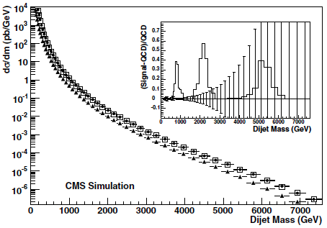
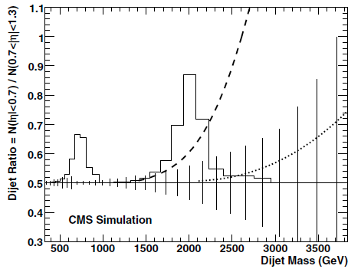
di-Jet Mass
JES main source of systematics
50 – 60 % effect on m_{jj} distribution
To reduce the systematic make the ratio between central and forward di-Jets
Enables precise tests of QCD at the LHC Start-up
Ratio
is also sensitive to Contact Interactions
Sensitivity to Resonances
J.Phys.G36:015004,2009
∫ L dt =
100 pb⁻¹
√s = 14 TeV
∫ L dt =
100 pb⁻¹
Sensitivity to
Resonances
Λ = 3 TeV
dσ/dm_{jj} (pb/GeV)
dσ/dm_{jj}(|η|<0.7)/dσ/dm_{jj} (0.7<|η|<1.3)
√s = 14 TeV
di-jet Mass (GeV)
di-jet Mass (GeV)

Slide 24
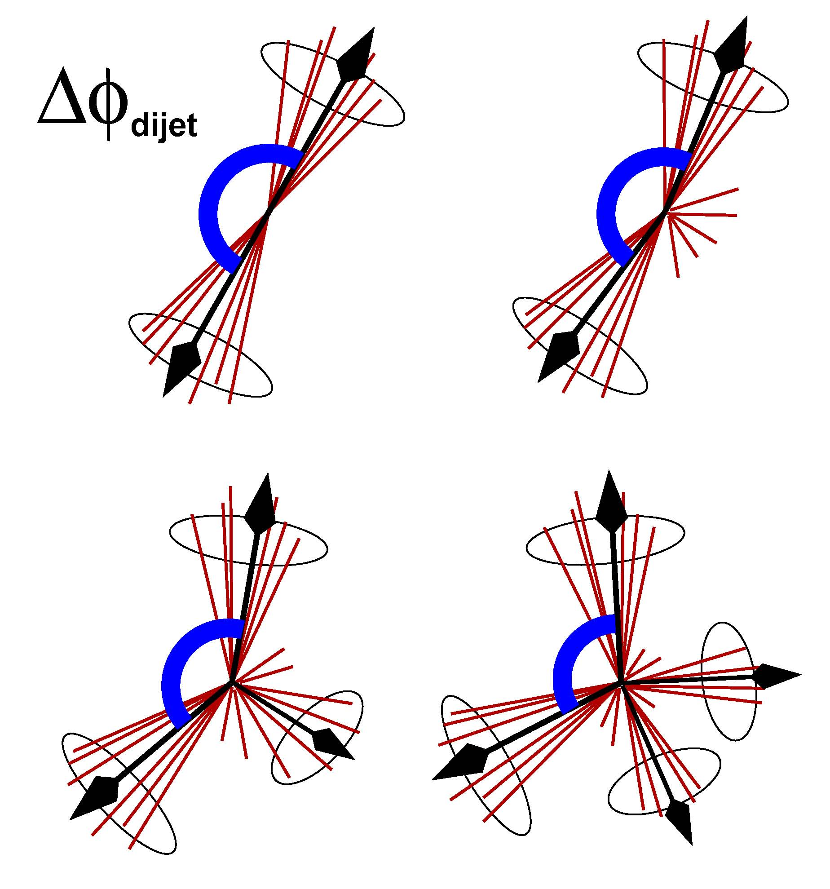
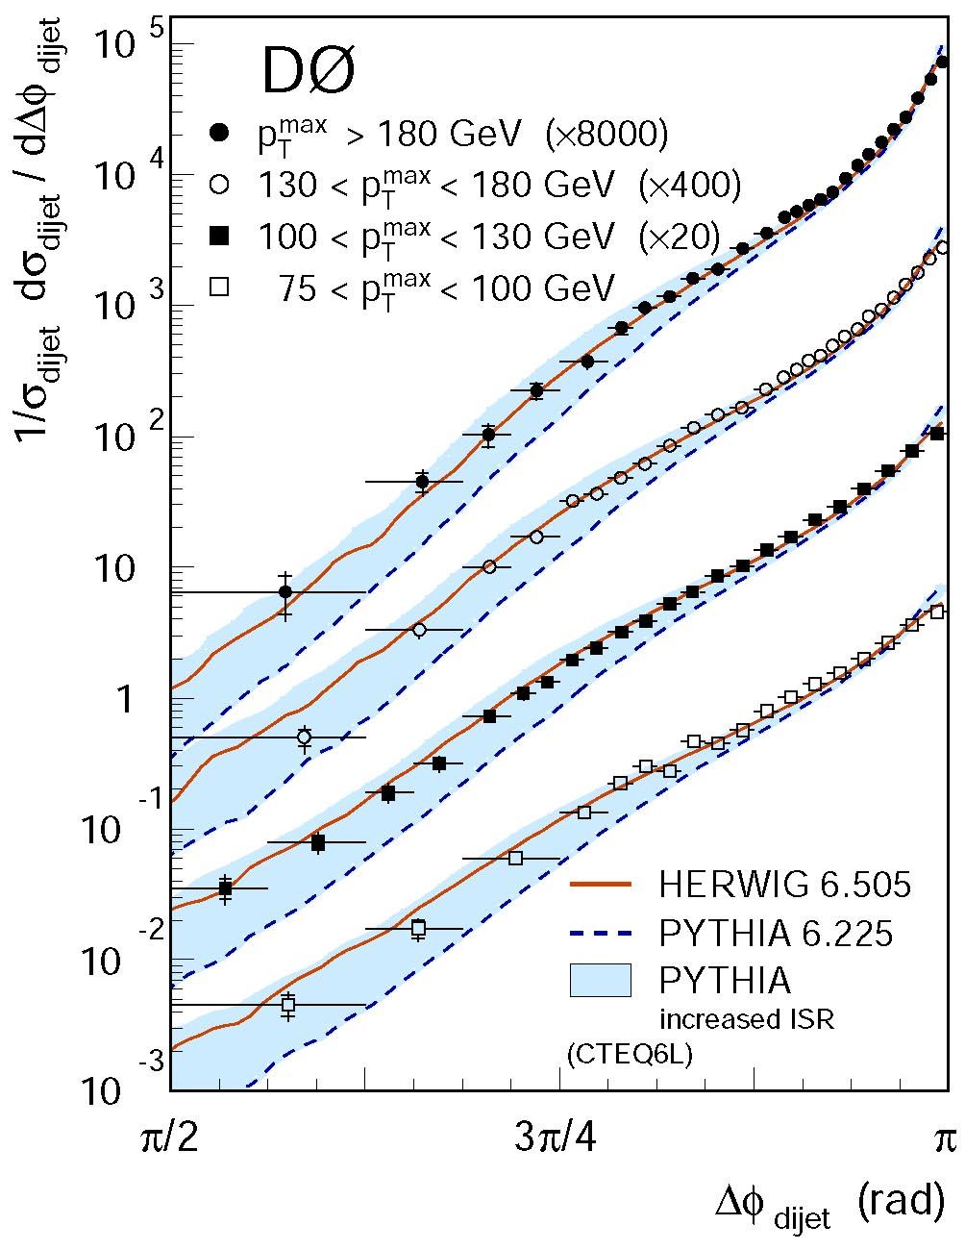
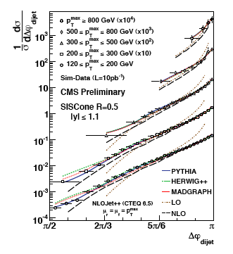
Jet Azimuthal decorrelations: effects of radiation
Why? 1) Understanding QCD radiation + Tuning of ISR parameters in QCD Models
2) Handle on multi-jet final states (irreducible backgrounds in many LHC searches )
Δφ dijet = π → Exactly 2 jets, no radiation
Δφ dijet small deviations from π → Soft radiation
Δφ dijet ≈ 2π/3 → One additional high- P_{T} jet
Δφ dijet ≈ π/2 → Multi-jet in the final state
insensitive to many
experimental uncertainties
P_{T}>800 GeV !
P_{T}>180 GeV
CMS Physics Analysis Summary QCD-09-003
10 pb⁻¹
10 TeV
Δφ Jet#1-Jet#2
Δφ Jet#1-Jet#2
Notes:
We have presented a study of dijet azimuthal decorrelations intended for early data at CMS
corresponding to an integrated luminosity of 10 pb−1. Since this is a shape analysis, the observable
is insensitive to many experimental uncertainties. Differences in the Djdijet distributions
are visible among the PYTHIA, HERWIG++ and MADGRAPH event generators, and LO
and NLO pQCD predictions. The dijet azimuthal decorrelation distributions are found to be
mostly sensitive to initial-state gluon radiation and less sensitive to final-state radiation and the
data could be used to tune parameters in the MC event generators that control these radiative
effects.

Slide 25
Jet Shapes / Event Shapes

Slide 26
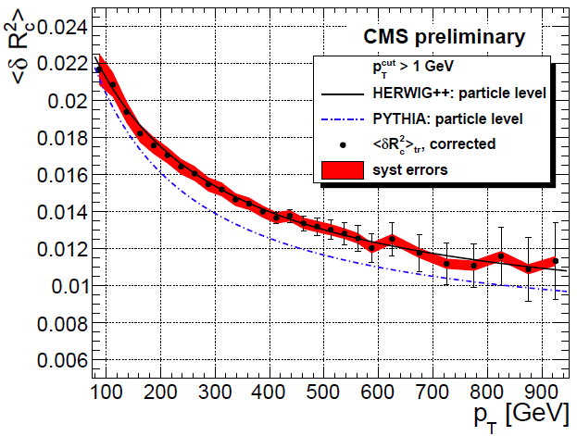
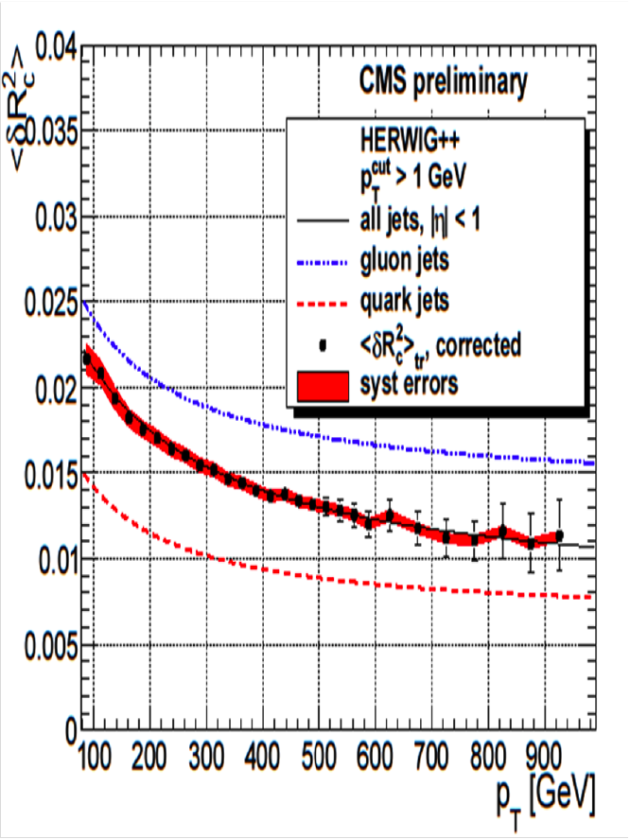
Jet Shapes with Charged Tracks
Second moment of the Jet profile in transverse momentum <δR²_{jet}>
Main Systematic from JES
tr
tr
tr
Sensitive to differences between the QCD Models
Large discrepancies Herwig++ vs Pythia6 depend on q vs g
CMS Physics Analysis Summary QCD-08-002
10 TeV
10 pb⁻¹
10 TeV
10 pb⁻¹
Notes:
The jet transverse structure is sensitive to event generator parameters which are responsible
for multiple parton interactions, parton showering and hadronization [3], and the fraction of
quark and gluon induced jets in a particular event sample can be measured.
The study of the jet transverse structure was performed using the second central moment of the
8 7 Conclusions
jet profile in transverse momentum
dR2
. The comparison of the generator level information
for PYTHIA and HERWIG++ shows that the fraction of quark induced jets, and their associated
second central moment
dR2c
ch in QCD dijet samples is the same for both generators in a wide
range of jet pT and h, however the prediction for
dR2c
ch for gluon induced jets is considerably
higher for HERWIG++ samples than for PYTHIA samples reflecting the difference of gluon
profiles included in these two generators. As a result the predictions for
dR2c
tr as a function
of pT are quite different for these two Monte Carlo generators. With an integrated luminosity of
only 10 pb−1, the estimated systematic and statistical uncertainties for
dR2c
tr measured with
the CMS detector are small enough to distinguish between these two Monte Carlo generators
and their tunes.
Once the Monte Carlo models have been tuned in a particular h range and they are shown to
describe the data well in other h regions, the fraction of quark induced jets as a function of jet
pT and h can be extracted from experimental data and compared with Monte Carlo predictions.
The Iterative Cone jet clustering algorithm was used here as this is currently the only jet finder
to which the JPT algorithm can be applied, however this analysis can be extended to other jet
clustering algorithms.

Slide 27
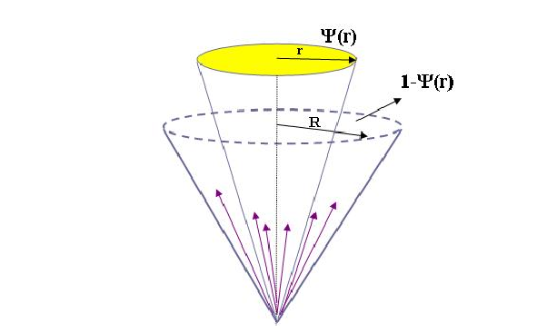
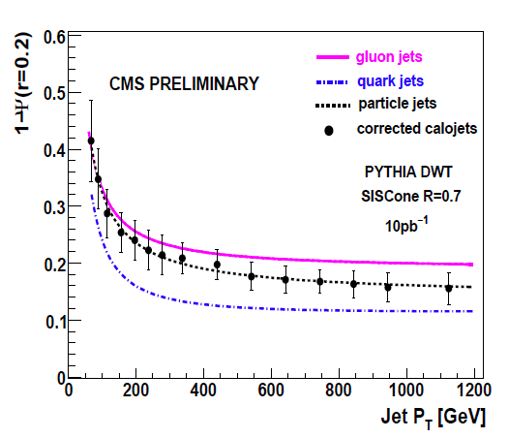
Jet Shapes with Calo Towers
Two Leading Calo Jets: SISCone
60 GeV< P_{T} < 1.4 TeV, |y| < 1
Consider Calo Towers P_{T}>0.5 GeV
JES (±10% at Start-up) changes jet shapes as jets migrate between different P_{T} bins.
ΔΨ(.1,.2) = 10%,5% for P_{T} < 100 GeV, and decreases with r
ΔΨ(.1) < 2% for P_{T} > 100 GeV
Distinguish between q and g Jets
Sensitive to MC Models/Tuning
Herwig++ vs Pythia6
DWT vs DW Pythia6 Tunes
Ψ(r) = P_{T} fraction inside cone of radius r
CMS Physics Analysis Summary QCD-08-005
14 TeV
Notes:
Using PYTHIA and HERWIG++ MC simulations, we have investigated a technique to measure
jet shapes in pp collisions for the two leading jets in the kinematic region 60 GeV< PT < 1.4 TeV
and |y| < 1. Particle level jet shapes were determined from calorimeter jets using corrections
derived from PYTHIA MC events.
Several sources of systematic uncertainties were investigated, arising from jet energy calibration,
jet fragmentation, calorimeter response and transverse showering, as function of jet PT
and distance from jet axis r. The systematic uncertainty is dominated by overall jet energy
scale, jet fragmentation and calorimeter simulation. The total systematic uncertainty at r=0.2 is
12% at PT=60 GeV, decreasing to 4% at jet PT=1 TeV.
As expected in QCD, jet shapes are observed to become narrower at increasing jet PT. Different
underlying event tunes (PYTHIA DWT and PYTHIA DW) were studied. PYTHIADWtends to
produce narrower jet shapes in the low PT region. QCD predicts different shapes of jets originating
from quarks and gluons. A measurement of the jet shapes in the context of the PYTHIA
Monte Carlo gives an estimate of the fraction of gluon initiated jets in data as a function of jet
PT.

Slide 28
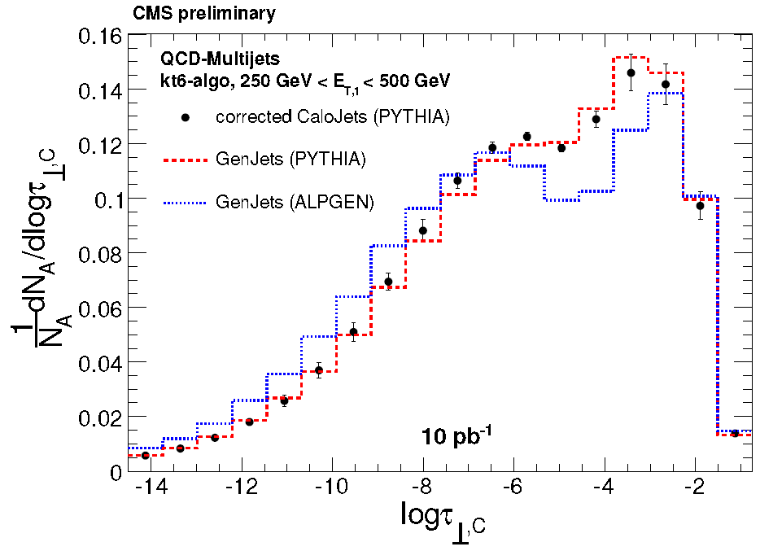
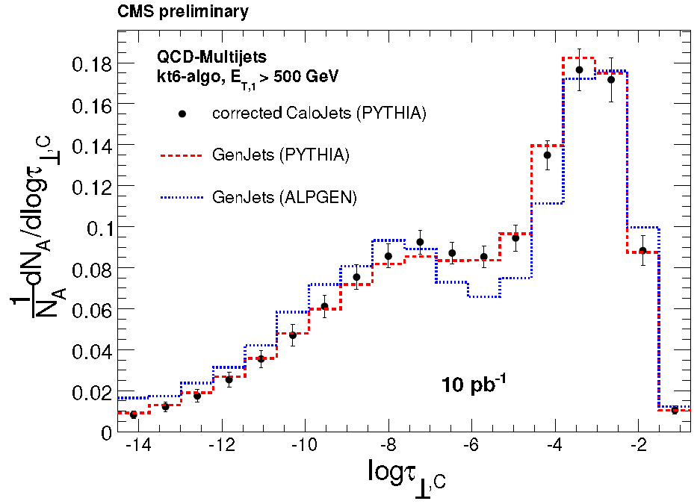
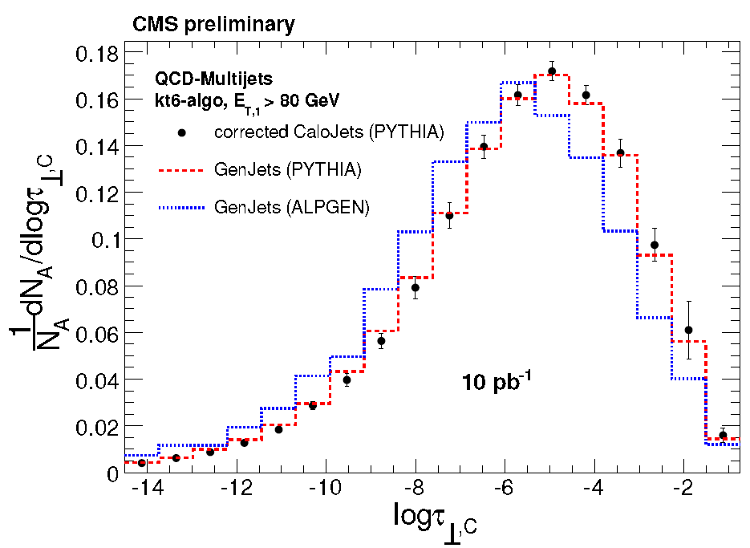
Event Shapes with Jets in the central region
Transverse Global Thrust, defined for different P_{T} thresholds of the 1st Jet
Secondary jets above 60 GeV
Restrict to jets in the Central Region |η_{jet}| < 1.3
Reduced dependency on JES, JER
Distinguish between boosted and spherical topologies
Sensitive to the differences between the models
ALPGEN vs Pythia
CMS Physics Analysis Summary QCD-08-003
14 TeV
Growth of the spherical peak at high P_{T} but also larger tails in the boosted region
← Boosted →
← Spherical →
Central Region

Slide 29
Conclusions
Rich QCD Measurement programme in CMS with emphasis on the LHC Start-up
MB, UE, Shapes, Jet P_{T}, di-jet Mass & φ-Decorrelations, Photons
Basic QCD measurements
Study QCD Backgrounds, Tune the MC Models
Sensitivity to large m resonances, contact interactions
Low P_{T} measurements mostly relying on the performance of the tracker
Jet Energy Scale dominating uncertainty in serveral Calo based measurements
Angular and Shape observables less affected
Ratio techniques

Slide 30
BACKUP

Slide 31
pQCD Models – Multiple Parton Interactions
ISR, FSR, SPECTATORS…
Not enough to account for
the observed multiplicities
& P_{T} spectra
The Pythia solution:
[T. Sjöstrand et al. PRD 36 (1987) 2019]
Multiple Parton Interactions (MPI)
(now available in other general purpose MCs: Herwig/Jimmy, Sherpa, etc.)
→
Main Parameter:
P_{T} cut-off P_{T0}
Inspired by observations of
double high P_{T} scatterings
Cross Section Regularization for P_{T}→ 0
P_{T0} ~ inverse of effective colour screening length
Controls the number of interactions hence the Multiplicity: < N_{int} > = σ_{parton-parton} /σ_{proton-proton}
Tuning for the LHC (emphasis on the Energy-dependence of the parameters) MB N_{ch} ,pT_{ch}
(dampening)
Pythia MPI Model with Varying impact parameter between the colliding hadrons: hadronic matter is described by Gaussians
Further correlations introduced in new Pythia MPI [Eur.Phys.J.C39(2005)129 + JHEP03(2004)053]
Recent MB data from CDF available
<N_{ch}> vs <pT_{ch}>
Impact
Parameter
d
Introduce IP correlations in
Multiple Parton Interactions →
Describe Tails!

Slide 32
Reference MC Settings in CMS
Tools for shower+hadronisation: PYTHIA primary choice (6.4 series), HERWIG (6.5 series) useful crosscheck (and used for MC@NLO). Growing interest for Sherpa.
PYTHIA: CMS uses old Q² ordered shower
new (p_{T} ordered) showers still need more validation/tuning against Tevatron jet data
PDF settings: LO PDF CTEQ6L1 (LHAPDF=10042).
NLO PDF used only for NLO generators and for determining errors.
Need iterations to tune PDF with the use of LHC data.
PS radiation and fragmentation (b, light quarks)
settings: used from LEP tunings (see for instance
CMS note 2005/013).
Need to re-tune to LHC data. Maybe a different
approach necessary when using external ME to
Parton Showers?
Underlying Event (see Tune tables in backup slides)
D6T tuning (by R. Field), using CDF data and default P_{T} cut off extrapolation at LHC energies
+ some guidelines to evaluate the uncertainties (for example impact on isolation observables)
Trend to favor higher value of the P_{T} cut off in MPI (à la Tune A) in more recent UE tunes
Default tunes for HERWIG/Jimmy
R. Field
CTEQ5L
CTEQ6L
CTEQ6M

Slide 33
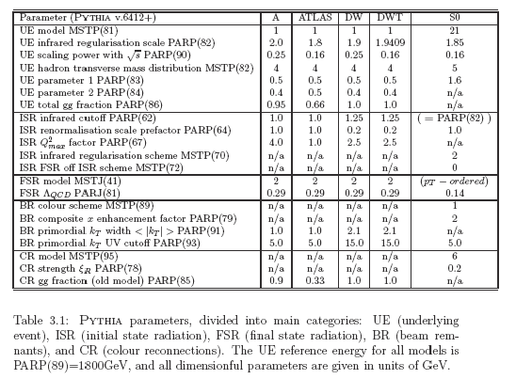
Pythia CTEQ5L Tunes
Tune A, DW, DWT
[R.Field]
Tune S₀
[P.Skands]
Current CMS reference: D6T
D6T = DWT with CTEQ6L PDF and PARP(82)=1.8387
P_{T0}(√s)= PARP(89)*(√s/PARP(89))^{PARP(90)}

Slide 34
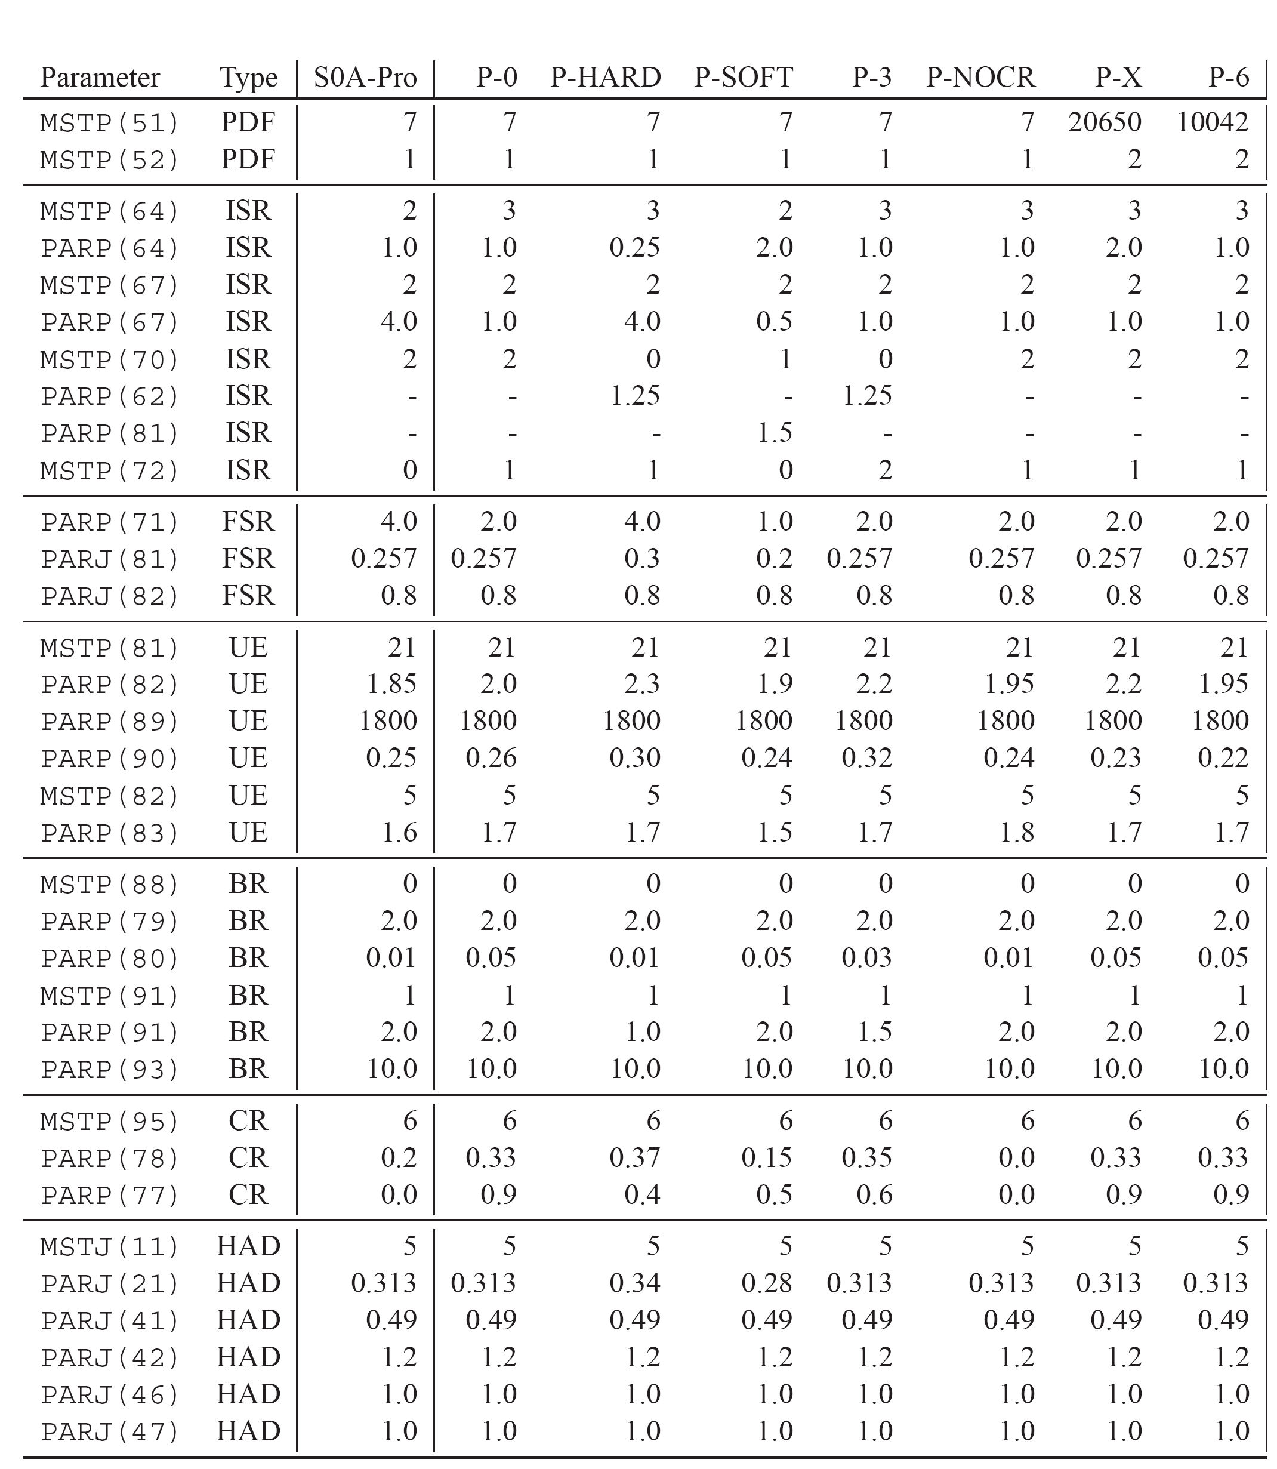
[P.Skands, 1st MPI@LHC w/s – Perugia 2008 & 1st Joint w/s on Energy Scaling of Hadron Collisions, Fermilab 2009]
Tunes can be selected with MSTP(5)=id, Perugia tunes available only from Pythia 6.4.20
300: S0: First Sandhoff-Skands Tune of the "new" UE and shower framework, with a smoother matter profile than Tune A, 2 GeV of primordial kT, and "colour annealing" color reconnections. Uses the default Pythia energy scaling rather than that of Tune A.
320: Perugia 0: "Perugia" update of S0-Pro.
321: Perugia HARD: Systematically "hard" variant of Perugia 0.
322: Perugia SOFT: Systematically "soft" variant of Perugia 0.
323: Perugia 3: Variant of Perugia 0 with different ISR/MPI balance and different collider energy scaling.
324: Perugia NOCR: "Perugia" without color reconnections.
325: Perugia X: Variant of Perugia 0 using MRST LO* PDFs developed by R.Thorne.
326: Perugia 6: Variant of Perugia 0 using CTEQ6L1 PDFs.
329: Pro-pT0: Tune of the pT-ordered showers and new UE framework made with Professor.
NOTE: All these tunes do not explicitly set MSTP(68), i.e. the main switch of the power showers.

Slide 35
CMS: p_{T}-η coverage
CMS Forward detectors:
Hadron Forward Calorimeter HF: 3 ≤|η| ≤ 5
Castor Calorimeter: 5.2 ≤|η| ≤ 6.5
Beam Scintillation counters BSC
Zero-Degree Calorimeter ZDC
p_{T}^{max} ~ √s exp(-η)
p_{T} (GeV)
1000
CMS
Central
Detectors
100
T1
T1
10
T2
T2
HF
HF
1
ZDC
ZDC
Extended
Tracking
0.1
RP
CASTOR
CASTOR
RP
-12
-10
-8
-6
-4
-2
0
+2
+4
+6
+8
+10
+12
η

Slide 36
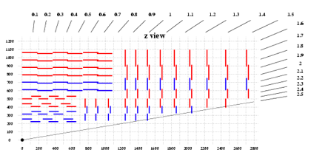
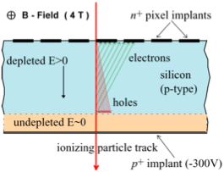
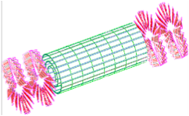
The CMS tracker
SiStrip + Pixel

Slide 37
MB & UE: Definitions & Terminology
Minimum Bias (MB)
The generic single particle-particle interactions.
Elastic + Inelastic (including Diffractive). ~ 100 mb @ LHC.
→ Soft. Low P_{T}, low Multiplicity..
What we would observe with a fully inclusive detector/trigger.
At the LHC, several MB interactions can take place in a single beam crossing. <N_{int}> = L_{inst} * σ.
→ MB seen if “interesting” Triggered interaction also produced.
→ Pile-up effect.
Tracking detectors help to separate the different primary vertices.
Possible overlap of clusters in calorimeters. Need energy flow.
Underlying Event (UE)
All the activity from a single particle-particle interaction on top of the “interesting” process.
Initial State Radiation (ISR).
Final State Radiation (FSR).
Spectators.
… Not enough! What else ??? (Will see in a moment…).
The UE is correlated to its “interesting” process.
Share the same primary vertex.
Events with high P_{T} jets or heavy particles have more underlying activity →Pedestal effect.
Sometimes useful! Ex. Vertex reconstruction in H→γγ.
UE ≠ MB but some aspects & concepts are similar.
Phenomenological study of Multiplicity & P_{T} of charged tracks.

Slide 38
MB & UE: Motivations
Study of “soft” QCD
Exploring Fundamental aspects of hadron-hadron collisions
Structure of Hadrons, Factorization of interactions
Energy dependence of cross sections and charged multiplicities
→ Tuning of Monte Carlo Models
→ Understanding the detector
Occupancies, Backgrounds, etc.
→ Calibration of major physics tools
Jet Energy, Missing Energy, Jet Vetoes, Vertex Reconstruction, Photon/Lepton Isolation
Regge:
s
α_{P}(s) - 1
Froissard bound:
(ln s)
2

Slide 39
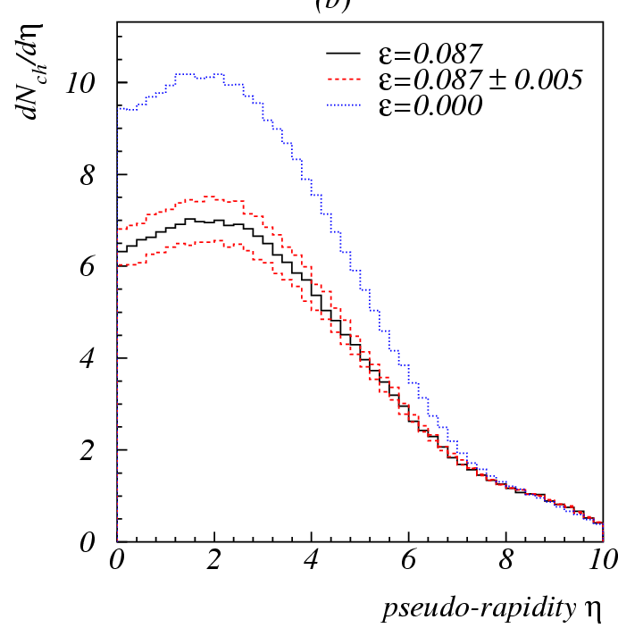
MB: Average Charged Multiplicity (Central Region)
[CERN 2000-004, pgg 293-300]
Extrapolation to the LHC Energy
UA5 at √s = 53, 200, 546, 900 GeV
[Z. Phys. C 33 (1986) 1]
CDF at √s = 630, 1800 GeV
[PRD 41 (1989) 2330]
Agreement With
Phenomenological Fit
NSD
[CERN 2000-004, pgg 293-300]
“post Hera” PDFs have increased color screening at low x ?
x g(x,Q²) → x^{-ε} for x → 0
P_{T} cut-off adjusted to reproduce the measured multiplicity for each PDF
P_{T} cut-off fitted with exponential function
Untuned
CTEQ4L
Tuned
⎛
⎞
2ε
⎜
^{s}
⎟
P
=
P
LHC
NSD
T
0
T
0
⎜
14
TeV
⎟
⎝
⎠

Slide 40
Side Note on the energy dependency of the P_{T} cut-off in the MPI Models
G.Gustafson & G.Miu
rather suggest energy independency of the P_{T} cut-off.
Minijets and transverse energy flow in high-energy collisions. [Phys.Rev.D63:034004,2001]
Hadronic collisions in the linked dipole chain model. [Phys.Rev.D67:034020,2003]

Slide 41
Quarkonia also prefers dampening...
Phys. Rev. D71: 032001, 2005
NRQCD
PYTHIA
Total
Color octet
Color-singlet
CTEQ6L |y|<0.6
NRQCD
PYTHIA
Total
Color octet
Color-singlet
CTEQ6L |y|<0.6
CDF data
disagreement
at low P_{T}
p_{T0}=2.85 GeV → nice agreement
[M.Bargiotti]
[M.Bargiotti]
Regularization natural: gluon exchange in the t channel dσ/dP_{T}² ~ 1/ dP_{T}⁴
Let’s assume universality: same P_{T0} of MPI, same energy dependency!

Slide 42
“Interleaved evolution” with multiple interactions
T. Sjöstrand & P. Skands - Eur.Phys.J.C39(2005)129 + JHEP03(2004)053
optional from Pythia 6.3
Underlying Event
(separate LARGE topic now …)
[P.Skands]

Slide 43
Basic Underlying Event Observables [R.Field et al., PRD 65 (2003) 092002]
Jet #1
Direction
Away
- “Charged jet” definition with R=0.7
- Assign all charged particles (P_{T}> 0.5 GeV/c) and |η|<1 to a jet
Δφ
Transverse
“Toward”
In the three different zones define:
Charged Multiplicity
Σ P_{T} (charged tracks)
Transverse regions are expected to be sensitive to the Underlying Event
“Transverse”
“Transverse”
Jet #1
Toward
“Away”
Transverse
Away
Rapid growth and then
constant plateau for PT(jet#1)>5GeV/c
Smooth connection between
Minimum bias and jet events

Slide 44
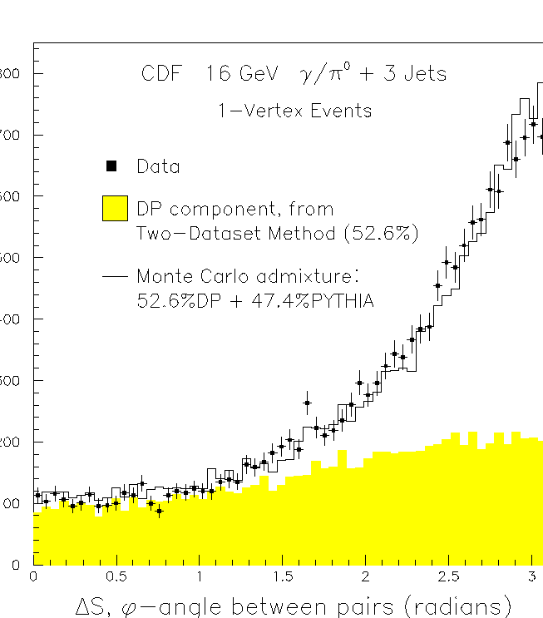
MPI: Just a successful MB&UE model or rather a real feature of nature ?
[Paoti Chang Fermilab Conf-97-175-E]
Double high P_{T} interactions observed by AFS, UA2, CDF!!!
[CDF Collab, Phys. Rev. Lett. 79, 584 (1997)]
In the simplest model, DP produces a final state that mimics a combination of two independent scatterings.
σ_{B} /(2σ_{eff}) is the probability of hard scattering B taking place given A, and this will be larger or smaller depending on the parton spatial density.
σ_{eff} contains the information on the spatial distribution of partons
m=2 for distinguishable scatterings
m=1 for indistinguishable scatterings
σ_{eff} ~ 14mb
DP

Slide 45
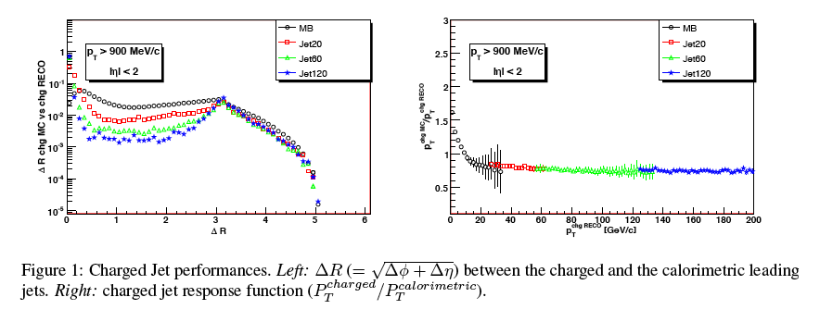
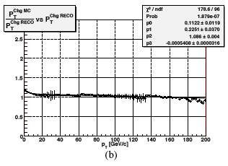
The Charged Jet
ΔR reco/calo
PT ratio reco/calo
PT>900 MeV/c
|η|<2
PT>900 MeV/c
|η|<2
CMS Physics Analysis Summary QCD-07-003
Charged jet instead of calorimetric:
+ access to low PT region
+ intrinsically free from pile up
+ better control of systematic effects at startup
PT ratio MC/reco
MC/RECO energy calibration of the leading charged jet

Slide 46
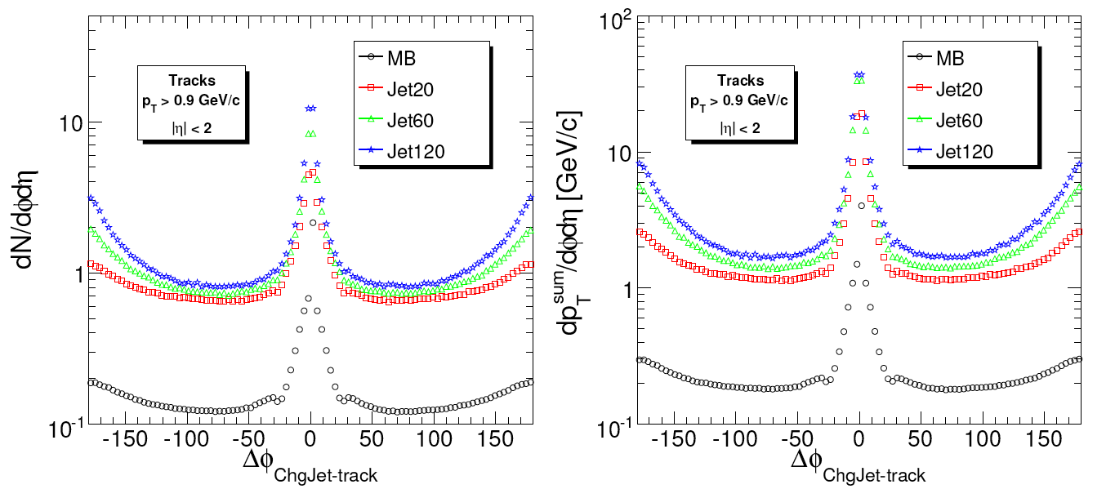
UE in jets: Activity VS distance to charged jet
UE Observables VS Δφ Leading Charged Jet Uncorrected distributions from 10pb⁻¹
Jet #1
Direction
Δφ
“Toward”
Toward
“Transverse”
“Transverse”
Tracks:
PT>0.9
|η|<2
“Away”
Tracks:
PT>0.9
|η|<2
CMS Physics Analysis Summary QCD-07-003
Away
Away
Transverse

Slide 47
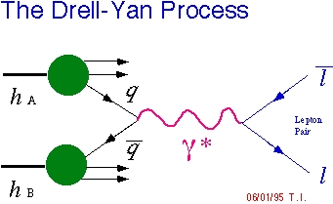
UE in Drell-Yan
2π
UE
region
of
interest
J. Phys. G: Nucl. Part. Phys. 34 995-1579
From D-Y muon pair production
(using muon triggers)
observables are the same but
defined in all the φ plane
(after removing the μ pairs everything else is UE)
φ
0
-2 2
η
RECO
RECO
MC
MC

Slide 48
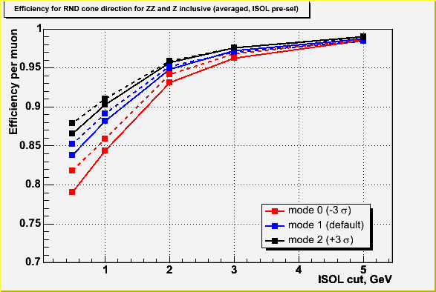
UE: Application to muon isolation in H→4μ search
(suppression of tt and Zbb backgrounds)
[CMS Note 2006/033]
1. How well can we predict the isolation cut efficiency using the current
Monte Carlo generators?
2. Can we calibrate the isolation cut efficiency using the experimental data
themselves and, if yes, would the associated experimental systematic
errors be smaller than the Monte Carlo based theoretical uncertainties?
Isolation parameter is a sum of P_{T} of tracks inside a cone dR(η,φ) = 0.3
(P_{T} of considered tracks > 0.8 GeV)
Random cone direction: all the calculations for isolation observable done for uniformly distributed random directions in event instead of directions for 'real' muons.
5% uncertainty
only in one cut
2% relative uncertainty
w.r.t. Drell-Yan
-3σ case (smaller PT_{cut-off})
-0σ case (default PT_{cut-off})
+3σ case (greater PT_{cut-off})

Slide 49
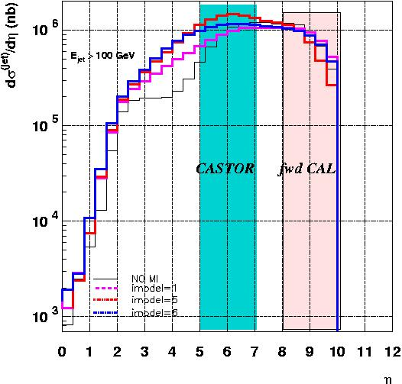
UE: Forward measurements using the CASTOR calorimeter
Generator Level Studies with Pythia 6.4x
Jet x-sec at forward rapidities
Understanding the dynamics measuring correlations between different rapidity ranges:
forward to very forward
forward to central
energy flow
Particle flow
Would the central measurement benefit from triggering on CASTOR ?
The energy taken by the beam remnant depends on the MPI Tune.
→ For further information on the tunes see Back-up slides
[K.Borras]

Slide 50
UE: Forward measurements using the CASTOR calorimeter
Long range correlations
central forward
no correlation
long range correlation
Pythia without MI -> no correlation
Pythia with MI:
Long range correlations, trigger enhancing differences in the central region
Generator Level Studies with Pythia 6.4x
→ For further information on the Tunes see Back-up slides
[K.Borras]

Slide 51
Quoting MPIs with paired charged MiniJets
Generator Level Studies
with Pythia 6.4x
Δφ distribution for the two most energetic charged Mini-Jets of the events
pp at 14 TeV
P_{T}^{jet} > 2 GeV
Pairing Algorithm:
- MiniJets ordered in decreasing P_{T}
- Start from the first
- Paired = jet with closest PT that satisfies the condition |Δφ⁰|<|Δφ|
14 TeV
|Δφ⁰|
Pythia 6.409, Tune DWT
Charged Particles
|η|<2.5, P_{T}>0.5GeV
R=0.5, Seed 1 GeV
Number of Pairs
MPI OFF
Generato r Level
Number of Pairs
MPI ON
Paired
14 TeV
The idea of the measurement is to study the Rates for a given number N of
Mini-Jet Pairs above a given P_{T} threshold -> Infrared Safe Quantity
Where σ_{inel} = σ_{soft} + σ_{H}
“S” = Single Interactions, “D” = Double Interactions, “H” = Hard
σ_{eff}(P_{T}) contains the information on the spatial distribution of partons

Slide 52
Quoting MPIs with paired MiniJets
Generator Level Studies
with Pythia 6.4x
N = Number of jet pairs for different η, P_{T}^{track}, P_{T} ^{jet}
Tracks:
PT>0.5
|η|<2
Tracks:
PT>0.5
|η|<5
Tracks:
PT>0.9
|η|<2
P_{T} ^{jet} > 2 GeV
P_{T} ^{jet} > 2 GeV
P_{T} ^{jet} > 2 GeV
Tracks:
PT>0.5
|η|<2
Tracks:
PT>0.5
|η|<2
Tracks:
PT>0.5
|η|<2
P_{T} ^{jet} > 6 GeV
P_{T} ^{jet} > 10 GeV
P_{T} ^{jet} > 20 GeV
P_{T}^{jet}
P_{T}^{jet}
N deeply depends on acceptance & efficiency

Slide 53
Quoting MPIs with paired MiniJets
Generator Level Studies
with Pythia 6.4x
σ_{eff}
Enhancement in the
probability of
additional interactions
P_{T} ^{jet}
σ_{eff} doesn’t depend on acceptance & efficiency (also from theory)

Slide 54
Double Parton Scattering in 4jet topologies
Disentangle double-parton-scattering from bremsstrahlung
pT(jet k)
pT(jet 3)
pT(jet j)
pT(jet 1)
pT(jet 2)
pT(jet i)
pT(jet 4)
pT(jet l)
No correlation (DPS) versus strong correlation Make use of different correlations between jet pairs
AFS solution:
Study Δφ between pT1 - pT2 and pT3 - pT4
CDF solution:
Study Δφ between pT1 + pT2 and pT3 + pT4 (CDF nomenclature: ΔS)
florian.bechtel@desy.de
CMS QCD Meeting, April 01st 2008
9

Slide 55
Double Parton Scattering in γ+3jet topologies
Generator Level Studies
Generator-level analysis
Combine γ (MC truth) with 3 jets (Midpoint-Cone, R=0.7) where ΔRij > 0.8
assign jets following UA2/CDF method (minimize imbalance)
pp → γ j + X
Pythia 6.413 p̂T > 20 GeV/c
- DWT (CMS default)
- S0 (→ colour reconnection)
Pythia 8.1 p̂T > 20 GeV/c
- default (physics ~ Pythia 6.4 S0)
- multiple parton-parton interactions switched off
+ simulate two hard jets
(in addition to γ j)
Herwig 6.510 p̂T > 20 GeV/c
- soft underlying event
- Jimmy 4.2

Slide 56
Double Parton Scattering in γ+3jet topologies
Generator Level Studies
ET (photon and jets) > 30 GeV/c
pp → γ j + X
Normalized to
highest bin
Pythia 6.413 p̂T > 20 GeV/c
- DWT (CMS default)
- S0 (→ colour reconnection)
Pythia 8.1 p̂T > 20 GeV/c
- default (physics ~ Pythia 6.4 S0)
- multiple parton-parton interactions switched off
+ simulate two hard jets
(in addition to γ j)
Herwig 6.510 p̂T > 20 GeV/c
- soft underlying event
- Jimmy 4.2
two hard int.
Pythia with MPI
Jimmy
no
MPI
→ large differences Pythia ↔ Herwig in separation variable ΔS
σ ~ nb promising for DPS detection

Slide 57
Double Parton Scattering
DP Component
[F.Bechtel]
Let’s extend these DPS studies to double boson, multi-HF, etc.

Slide 58
UE in Hard Diffractive Topologies
Single diffraction (SD)
Double Pomeron exchange (DPE)
p
p1
Roman
Pot
p
Scale given by X → Study UE(M_{X})
MPI in diffractive events are strongly suppressed
The Beam Remnant component is also strongly suppressed
(at least in the hemispheres with surviving protons)
Comparing with corresponding not diffractive topologies may allow to better disentangle the different UE components
Optimize LRG definition
X
forw. det.
gap
X
central +
forw. det.
p
gap
p
Roman Pot
p
gap
p2
Roman
Pot

Slide 59
Interplays Between Multiple Interactions and
Hard Diffraction at the LHC
Handle on soft multiple parton-parton interactions in hard diffractive events
Breaking of factorization in hard diffraction
Survival probability of protons and LRGs ~ e
- < N_{int} >
Where < N_{int} > = σ_{parton-parton} /σ_{inel proton-proton}
Our goal would be to give a more “concrete” meaning to the σ_{parton-parton} (P_{T}) numbers for example through the mini-jet pair counting method
[R.Field] | σ _{parton-parton} at 1.96 TeV | σ _{parton-parton} at 14 TeV
Tune A | 309.7 mb | 484.0 mb
Tune DW | 351.7 mb | 549.2 mb
Tune DWT | 351.7 mb | 829.1 mb
~ 80 mb
On the other hand there’s a well consolidated experimental methodology to measure hard diffraction from data
Extrapolate the dPDFs measured at HERA and Tevatron and compare the resulting cross section predictions for the LHC with the cross sections measured at the LHC
Measure F₂^{D}, via e.g. dijet production, in SD and DPE and compare

Slide 60
Inclusive Jet production – the legacy from past
1978 – Feynmann-Field model
predicts a large jet cross section
2006 – CDF 1 fb⁻¹
CMS Physics Analysis Summary QCD-08-001
2009/2010 – LHC 10 pb⁻¹
QCD just born!
+ PDFs Q² dependence predicted from QCD
Quark & Gluon Fragmentation Functions Q² dependence predicted from QCD
Quark & Gluon X-Sections Calculated from QCD
New interactions could be visible

Slide 61
Inclusive Jet production – EXP and TH uncertainties
Main experimental and theoretical sources of uncertainty
CMS Physics Analysis Summary QCD-08-001

