Slide 1
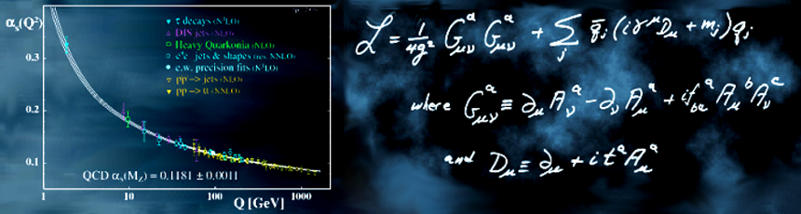
PDG α_{s}(m_{Z}) discussion
J. Huston, K. Rabbertz, (G. Zanderighi)
Les Houches 2023

Slide 2
PDG averaging for α_{s}(m_{Z})
Every two years, the QCD section in the Particle Data Book is updated; part of that update is a review of the world average of α_{s}(m_{Z}), revising it to include the impact of new measurements and calculations
The last revision was in 2021 (minor update in 2022)
The selection of results to include in the α_{s} averaging are restricted by the following considerations:
  published in a peer-reviewed paper at the time of the report (or is based on a summary of results that have been published in a peer-reviewed journal, such as the FLAG report)
  based on the most complete perturbative predictions of at least NNLO accuracy, accompanied by reliable estimates of all experimental and theoretical uncertainties

Slide 3
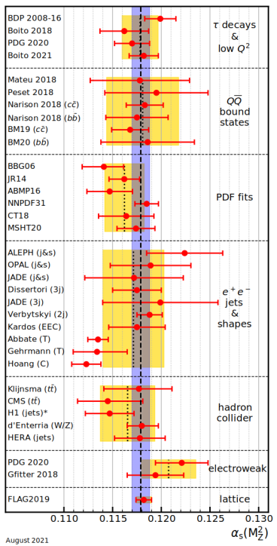
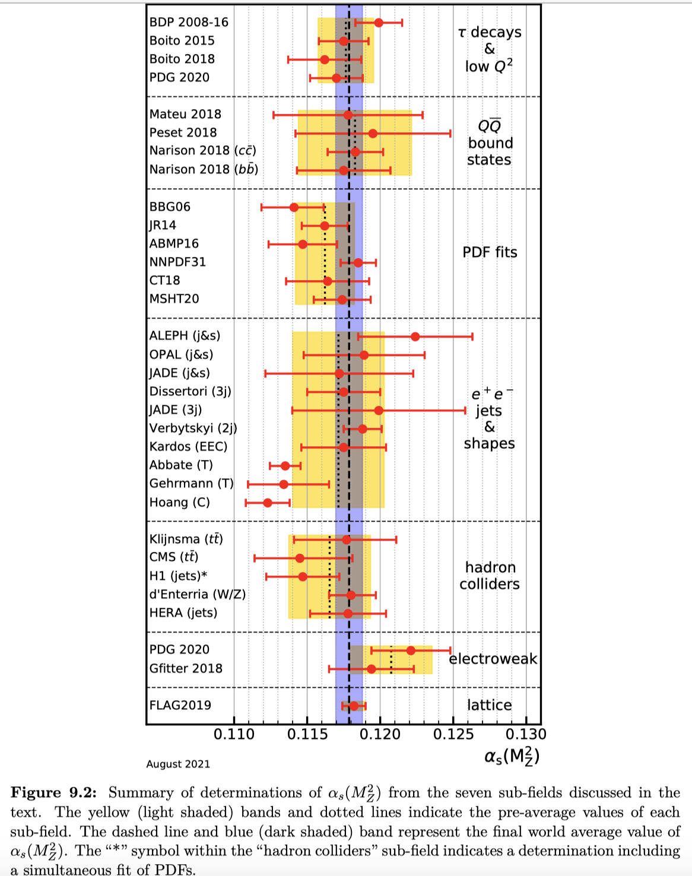
average of 3 results that are not
totally independent
2022 update
subdivision
into the
categories
shown has
been
in place
for some
time
The world average value of α_{s}(m_{Z}) was determined using results from 7 sub-fields
  hadronic τ decays and low Q² continuum
  heavy quarkonia decays
  deep-inelastic scattering and global PDF fits
  hadronic final states of e⁺e⁻ annihilations
  hadron collider results
  electroweak precision fits
The 7th sub-field is just the 2019 FLAG result
To be used, each result must be based on the most complete perturbative predictions (>=NNLO), have a reliable estimate of the uncertainty, and non-perturbative effects under control

Slide 4
Non-perturbative effects
Some inclusive quantities such as the e⁺e⁻ cross sections to hadrons have small non-perturbative corrections (~Λ⁴/Q⁴), while others such as event-shape distributions, can have corrections that go as Λ/Q
Analyses of the τ hadronic decay width and spectral functions are performed with N³LO predictions, but low Q (m_{τ}) results in non-negligible non-perturbative corrections, whose treatment differs among the different calculations
Collider measurements access the highest values of Q where non-perturbative effects are expected to be less important
Both collider and DIS/DY data go into global PDF fits, which themselves are dependent on non-perturbative forms

Slide 5
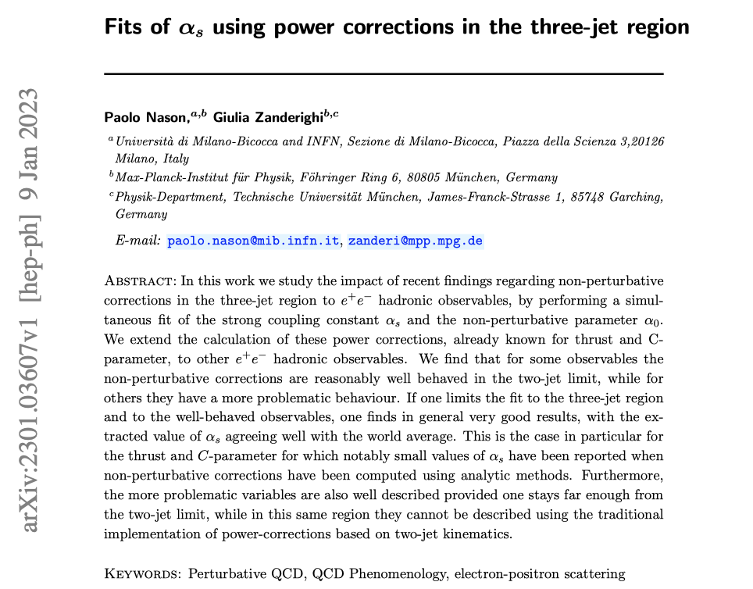
Significant advance

Slide 6








unweighted
averages of
central value
and uncertainties
within sub-fields
combination of first
6 pre-averages
using χ² averaging
gives
PDF fits often
do not have
explicit
estimate of
theory
uncertainty
issue of
whether
necessary
to do
simultaneous
PDF fit
C-parameter
talk of Monni
if use only H1, which
used PDF fit

Slide 7

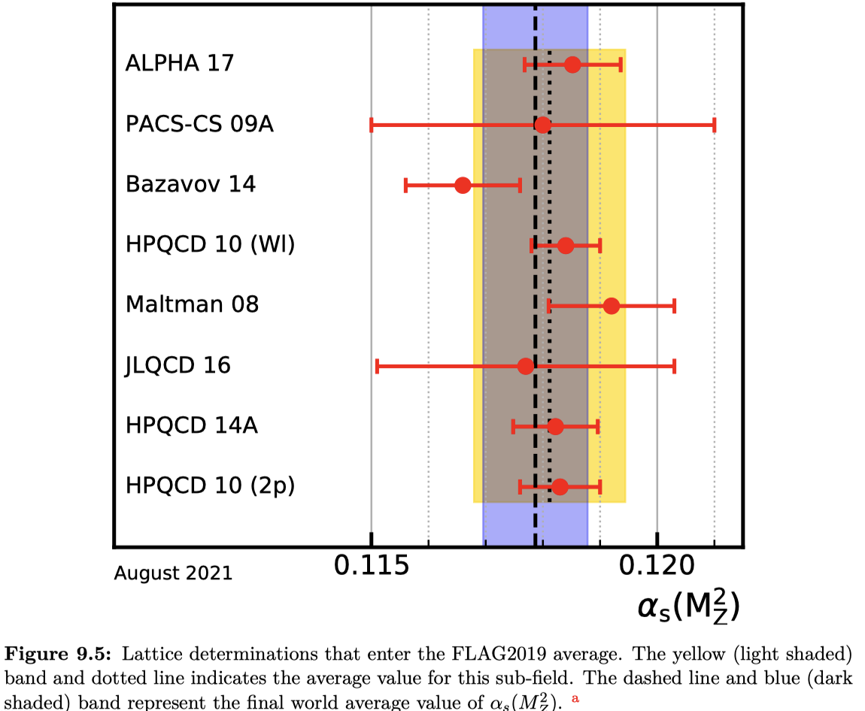

Results within sub-fields 1-6 were pre-averaged (using unweighted average)
FLAG19 result itself is an average and is taken as is
FLAG21 result (too late to be used in previous combination)

Slide 8


A non-lattice result was determined from sub-fields 1-6 using a χ²-averaging method
FLAG result itself is an average and is taken as is
Combine two numbers in un-weighted average, and take uncertainty as an average of the two uncertainties (conservative)
A weighted average of all 7 categories would give

Slide 9
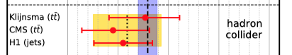
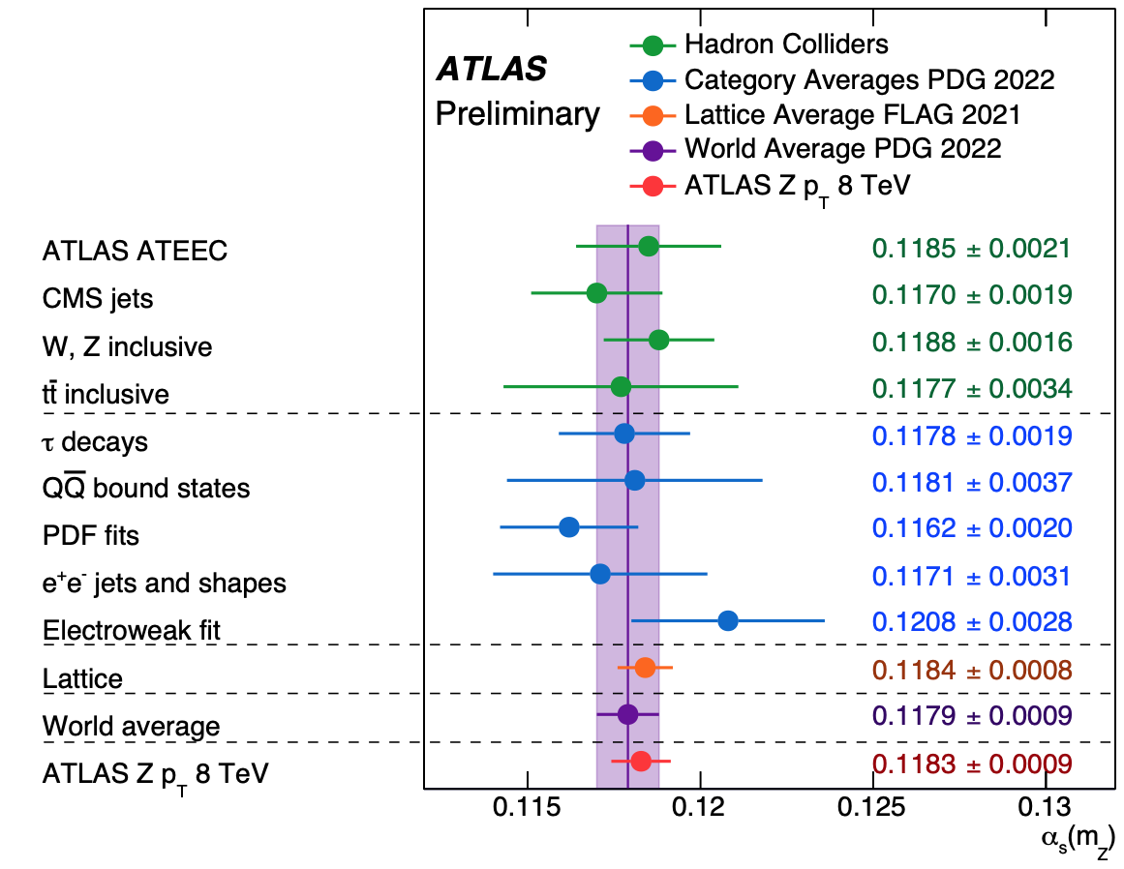
Collider measurements of α_{s}
As the number of NNLO calculations has increased, there have been a growing number of determinations of α_{s}(m_{Z}) at that order (or higher) from the LHC experiments that have nominal uncertainties that rival the full world average uncertainty
  Z p_{T}
  event shapes
It would be nice to understand those uncertainties better, especially if PDF uncertainties are taken into account
2022
N³LL+N³LO

Slide 10
New LHC results
Exp. | √s / TeV | Lumi / fb⁻¹ | Theory | Obs. | αs(MZ) | Δαs exp | Δαs oth | Δαs scl | Ref.
CMS | 13 | 33.5 | NNLO | Jet pT | 0.1166 | 14 (NP) | 7 | 4 | JHEP12(2022) 035
ATLAS | 13 | 139 | NNLO | TEEC | 0.1175 | 6 | 12 | +32 -11 | 2301.09351
ATLAS | 13 | 139 | NNLO | ATEEC | 0.1185 | 9 | 11 | +22 -2 | 2301.09351
CMS | 13 | 36.3 | NNLO | 2D mjj | 0.1201 | 12 (NP) | 9 | 8 | SMP-21-008
CMS | 13 | 36.3 | NNLO | 3D mjj | 0.1201 | 10 (NP) | 10 | 5 | SMP-21-008
ATLAS | 8 | 20.2 | N4LLa+ N3LO | Z pT | 0.1183 | 4 | 6 | 4 | CONF-2023-015

Slide 11
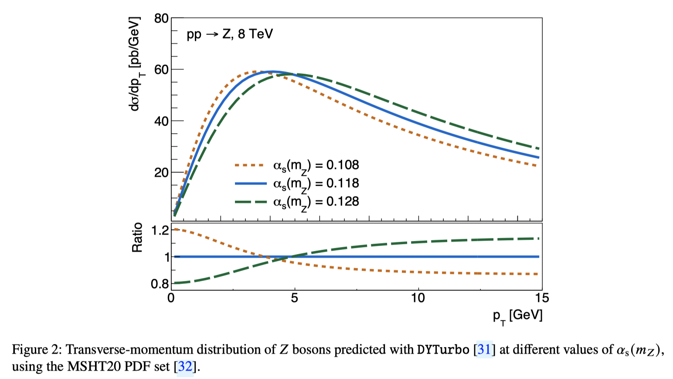
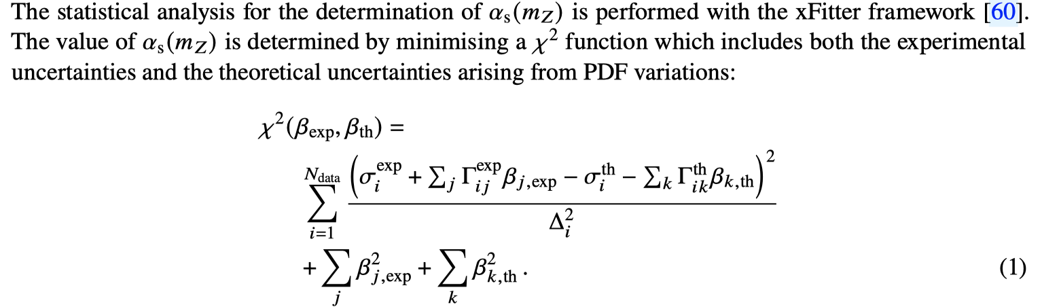

Slide 12
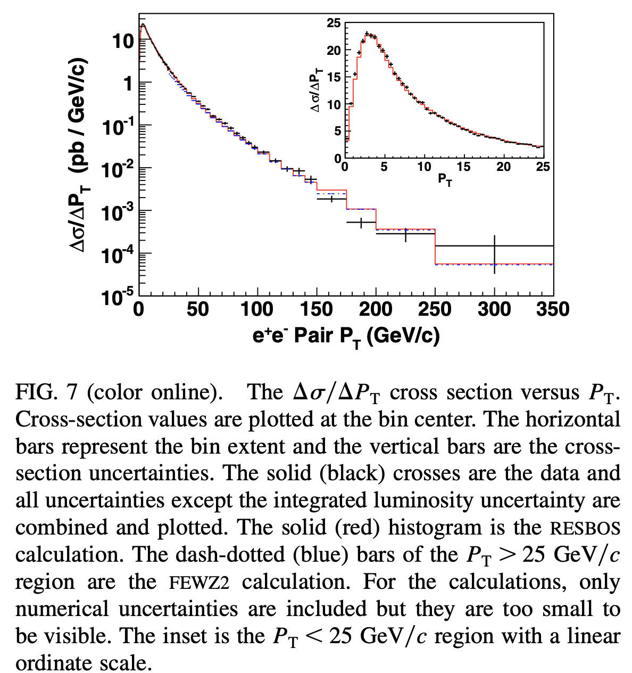
CDF

Slide 13
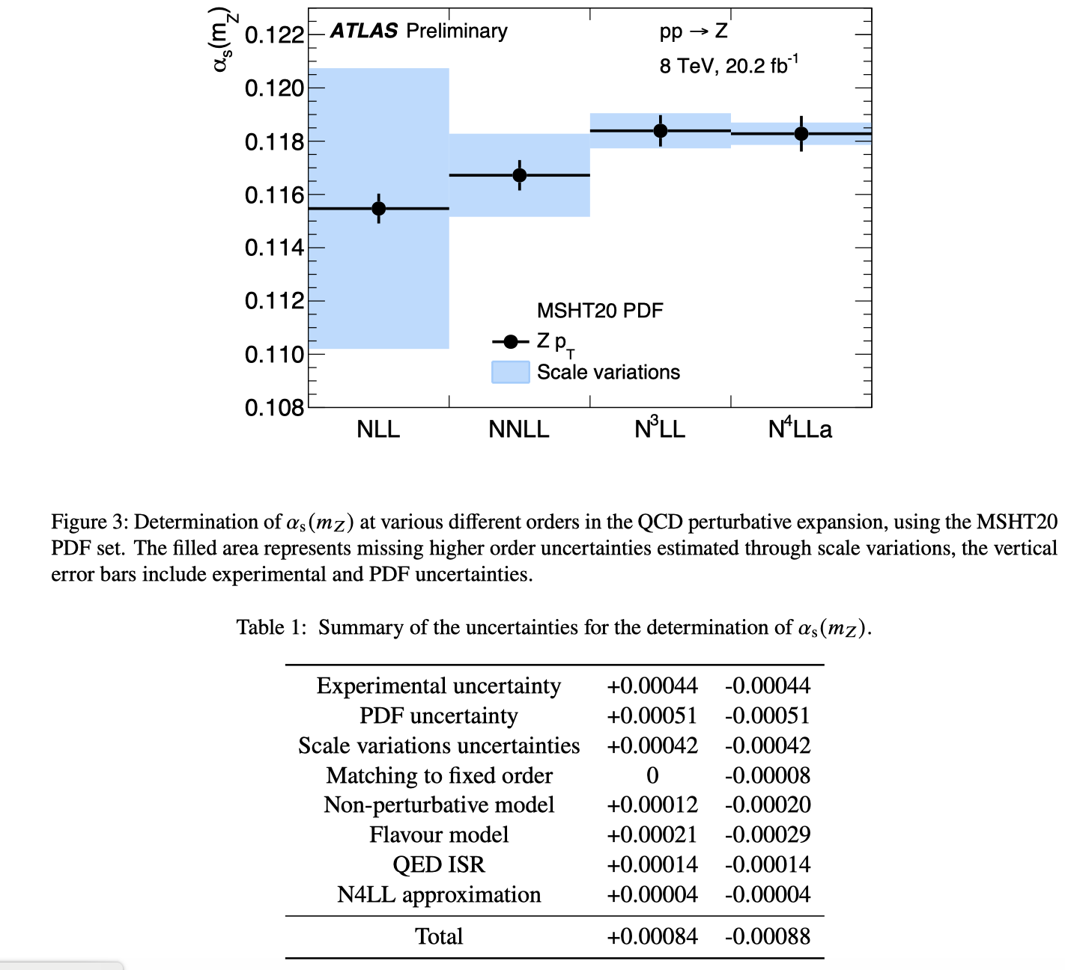
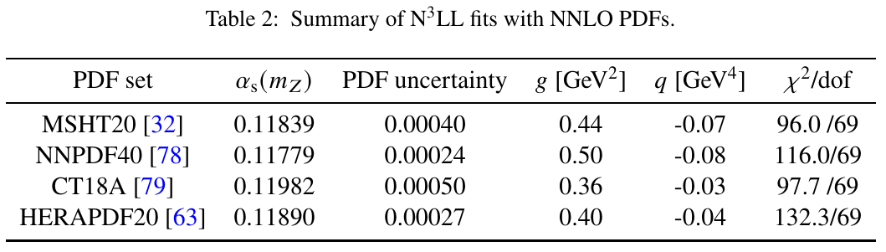

Slide 14
Running α_{s}

Slide 15
Looking forward
We have been considering lattice QCD determinations of α_{s} independently of experimental/phenomenological determinations
In the future, it may be useful to group lattice QCD determinations with experimental determinations of as that have systematics of similar origin
  del Debbio, Ramos; arXiv:2101.04672

Slide 16
Extras

Slide 17
Global PDF fits
There is a wide variety of data in modern global PDF analyses, over 3500 data points for CT18
The data includes DIS, DY (including precision W/Z), jet production, top production
All predictions at NNLO, all depending on α_{s}
...but the
power of α_{s}
depends on
the process
Born for DY is
α_{s}⁰; Born for
dijet/top
production is
α_{s}²

Slide 18
α_{s} and gluon (Lagrange multiplier studies)
Also, all of the experiments in the global fit do not speak with a unified voice, further weakening the discrimination power
We end up with a fairly parabolic χ² dependence of α_{s}(m_{Z}), but it’s clear that different experiments have different preferences
At 68% CL, α_{s}(m_{Z})=0.1166+/-0.0018 (for CT18 at NNLO)

