Slide 1
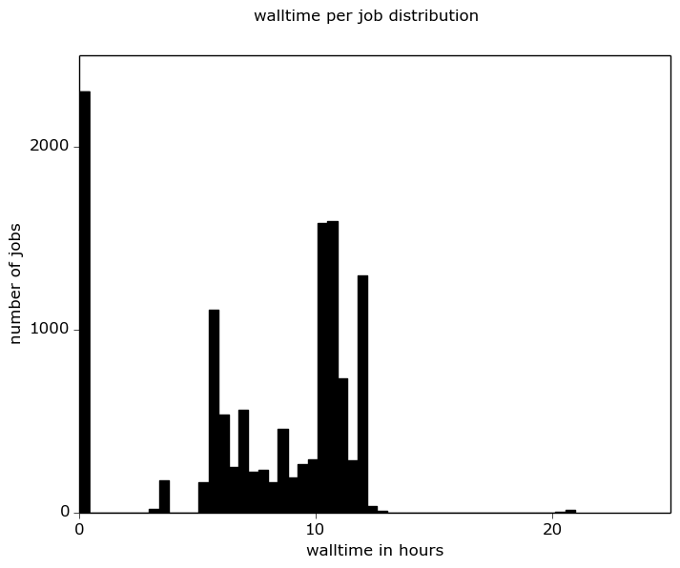
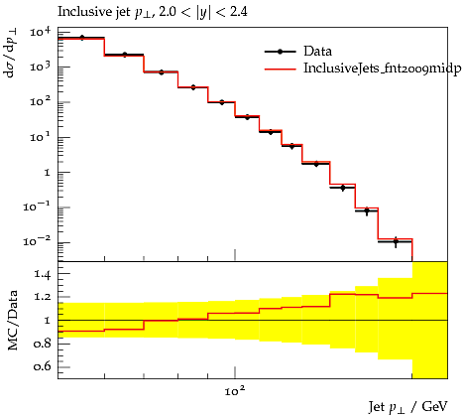
Inclusive Jet cross-section on
Freiburg bwForCluster
warmup
NLO
Using HPC Centers as private cloud provider allows any workflow to utilise these resources: vast additional computational power available to particle physicists now! (Software stack: OpenStack, HTCondor, GridControl)
800 virtualised CPUs
13 fastNLO scenarios
10¹² Events
94107 hours cpu-time
12511 jobs (10% warmup, 10% LO, 80% NLO)
LO

